Slide 1
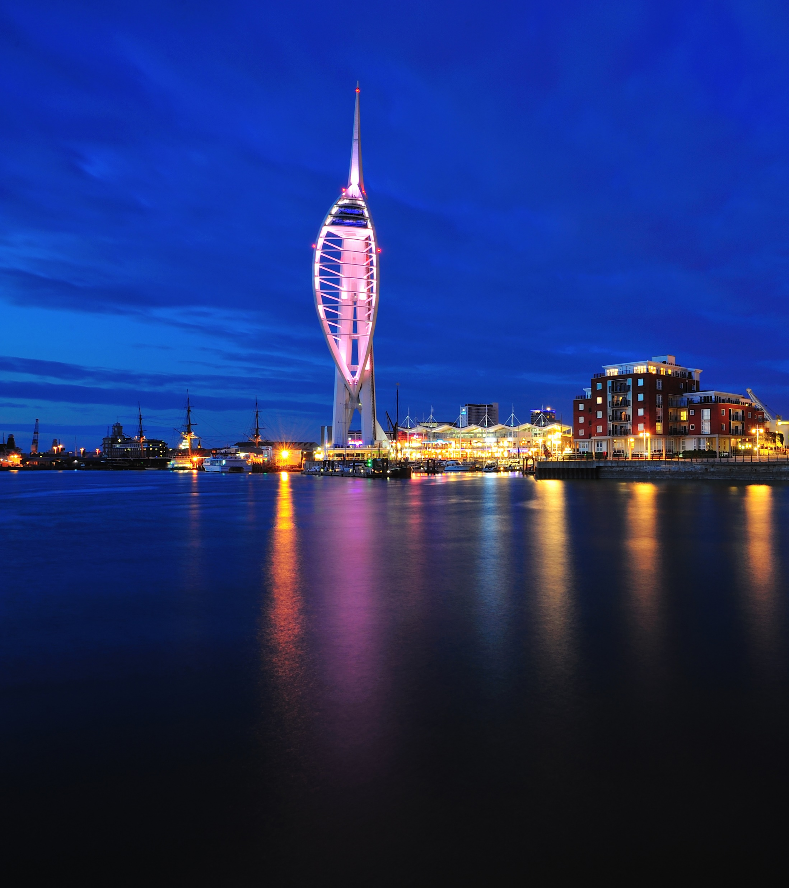
CLIMATE CHANGE PROJECT
SCHOOLS INFORMATION PACK:
SOS Save our Solent
&
Letters to Tomorrow

Slide 2
INTRODUCTION
WHAT IS THIS PROJECT?
This May, Portsmouth's’ Youth Cabinet were successful in winning funds from Save the Children from their Children and Young Peoples Climate Fund.
This fund is to raise the awareness of impacts from the climate crisis, and its effects on children and young people.
What’s Our Project?
With our funding we have created the SOS Save our Solent campaign, demanding Southern Water take immediate action to stop pollution in our seas.
Additionally, we invite schools to take part in a Letter to Tomorrow event, helping to get young peoples voices heard.

Slide 3
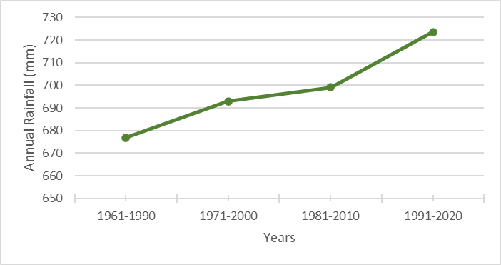
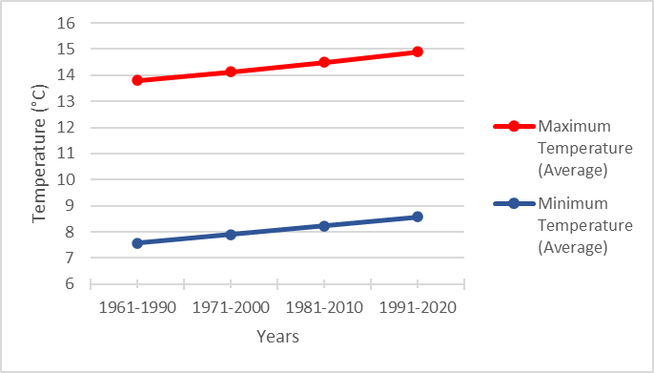
CLIMATE CHANGE IN PORTSMOUTH
Climate change is already here…
Since the 1960s, Portsmouth has recorded:
An average increase of 1°C to both winter and summer temperatures
An average of 7 less frosty days a year
An increase of 7% on annual rainfall, that’s an additional 50 mm of rain
This has meant flooding, heatwaves, damaged buildings and roads, travel delays, cancelled events and disrupted services.

Slide 4
SOS SAVE OUR SOLENT
The Campaign
Climate change means we are experiencing more heavy rainfall and our drainage networks aren’t managing the extra water well.
The result…
Southern Water are releasing untreated sewage into our sea. Our seas and beaches are some of the limited natural areas young people can access in Portsmouth, used all year round for swimming, walking, and water sports.
Portsmouth’s’ Youth Cabinet have created
SOS Save Our Solent raising awareness of the climate change risks effecting our local coasts.
The campaign…
We want Southern Water to take local action and support climate change adaptation in Portsmouth by supplying water butts to homes.
The solution…
Water butts are a simple solution that store the rainwater falling on roofs, and stop it over-whelming the sewer systems. Southern Waters own experiment on the Isle of Wight showed it reduced sewage release by 70%!

Slide 5
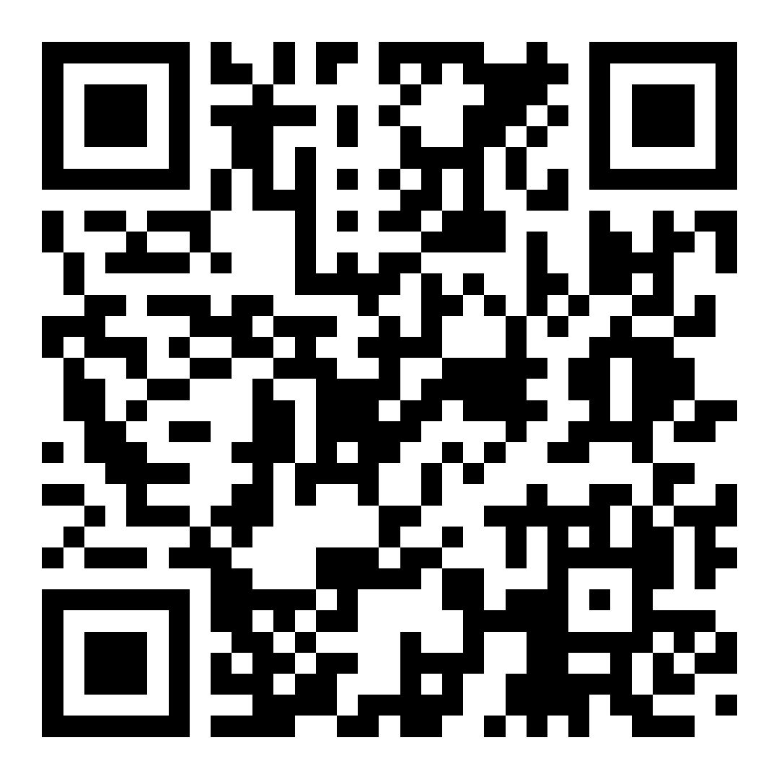
SOS SAVE OUR SOLENT
How to Get Involved
SOS Save Our Solent is a youth-led campaign.
We would like your support in this campaign by:
Screening our campaign video in your school
Signing and sharing our petition for action
Follow Portsmouth Youth Cabinet on Instagram, Facebook, TikTok or YouTube for more updates

Slide 6
LETTERS TO TOMORROW
How to Get Involved
Join us by hosting a Letters to Tomorrow event that provides a platform for youth voices to be heard.
What are Letters to Tomorrow?
Giving youth a platform to explain their hopes for future generations if our leaders step up to protect the environment – and their fears about what life could be like if we don’t slow down climate change.
It could be a short letter to their friend, their family, their future self, their MP, or local Councillor.
What’s Next?
Portsmouth City Council will collect letters from across Portsmouth schools, present to local leaders and publish them.
Need More Help?
There is guidance from Save the Children here
If requested, an officer or Councillor from Portsmouth City Council, or a member from Youth Cabinet may be able to help facilitate the event.
Contact for any questions, collecting letters or for help in facilitation Kristina.downey@portsmouthcc.gov.uk

Slide 7
OTHER YOUTH CABINET WORK
How to Get Involved
Upcoming projects on:
LGBTIQA+ inclusion
Supporting asylum seekers
Free school meals for all
Follow other Youth Cabinet projects here
Please contact Jo Morgan engenderingchangeconsultancy@gmail.com

