Slide 1
Young Carers in Schools
Overview and Q&A session
Updated Website and Guide
Young Carers in Schools (YCiS) Award

Slide 2
Introduction to YCiS
A free initiative that makes it as easy as possible for schools to support young carers, and awards good practice
Run jointly by Carers Trust and The Children’s Society, the Young Carers in Schools (YCiS) programme works with schools across England to share good practice, provide relevant tools and training, and celebrate the great outcomes many schools achieve for young carers.

Slide 3
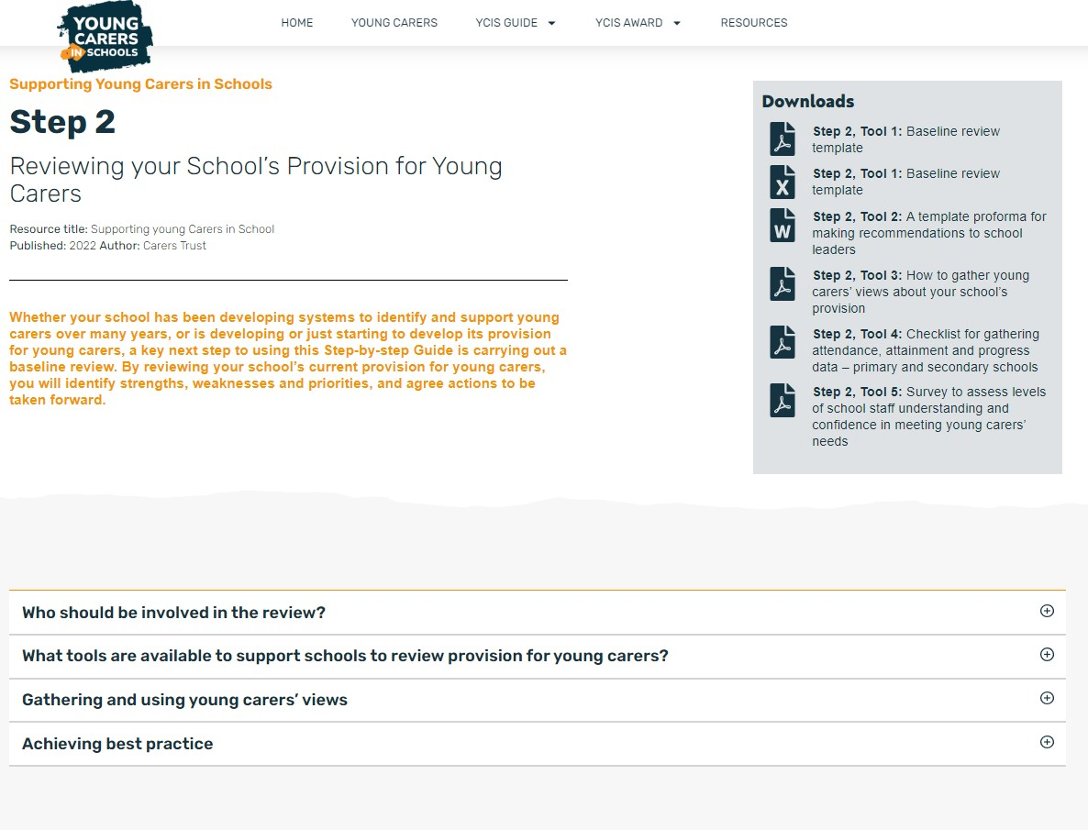
Updated Website

Slide 4
Updated Guide

Slide 5
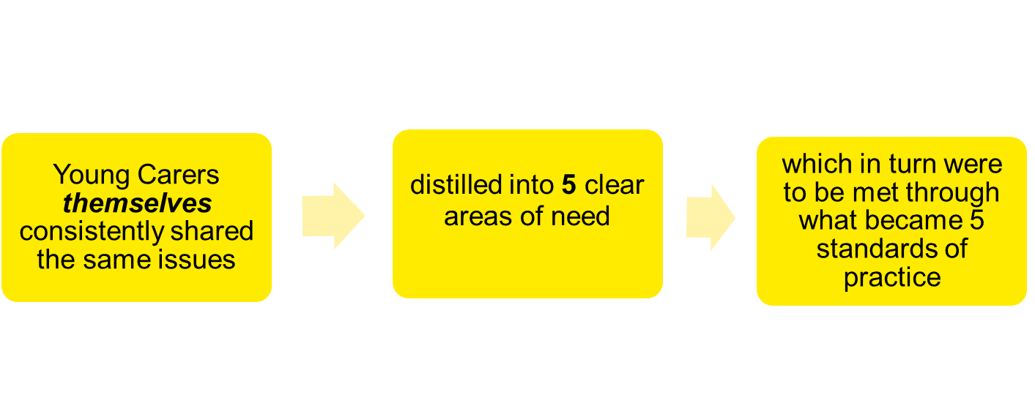
Young Carers in Schools
The Award

Slide 6
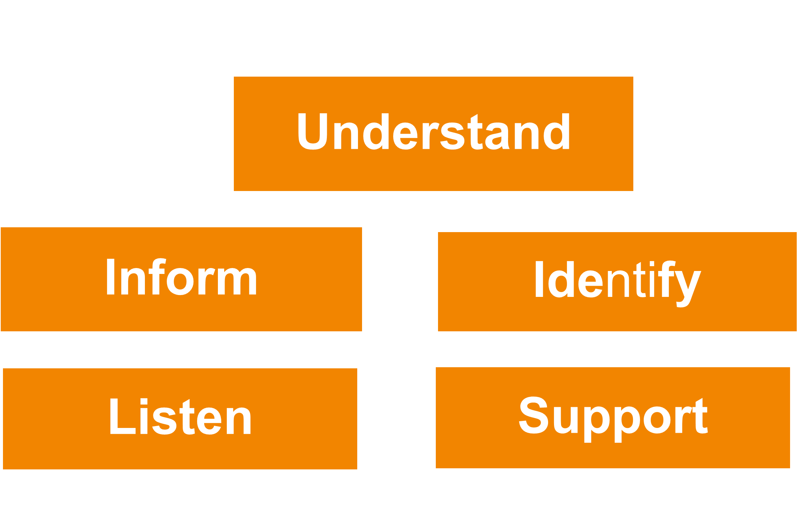
Young Carer Informed:
The Five Pillars

Slide 7
UNDERSTAND:
Appoint a Young Carer SLT lead and Operational lead. Responsible for understanding and addressing young carer needs.
Let pupils, families and staff know about the support in school for young carers and who to contact on the noticeboards and website.

Slide 8
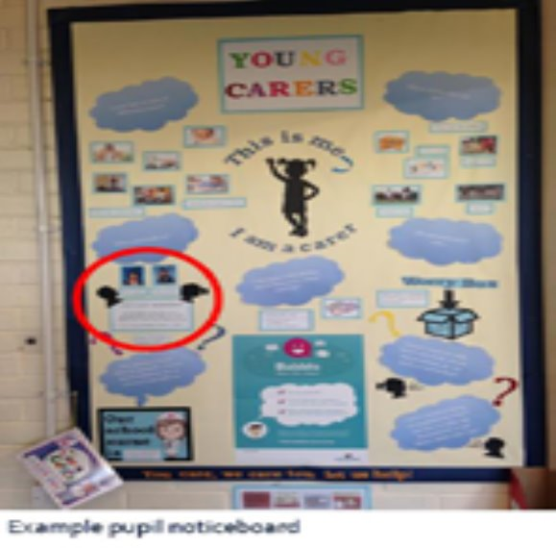
Standard One - Understand

Slide 9
INFORM:
Having an informative webpage specifically for young carers shows the schools commitment to whole school working
Staff noticeboard endorsed by SLT with their contact details
Copy of agenda/minutes from a recent governors meeting to show that young carer issues and the school’s support have been discussed

Slide 10
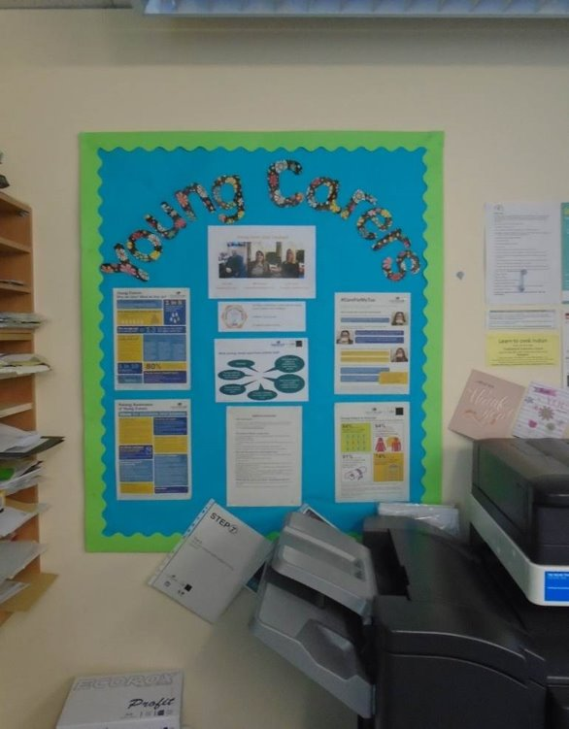
Standard Two - Inform
Screenshot of webpage showing Tab with Young Carers
Staff noticeboard

Slide 11
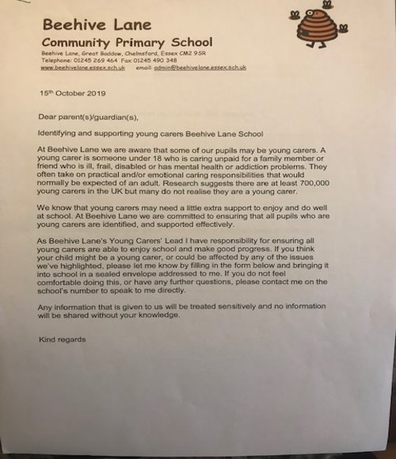
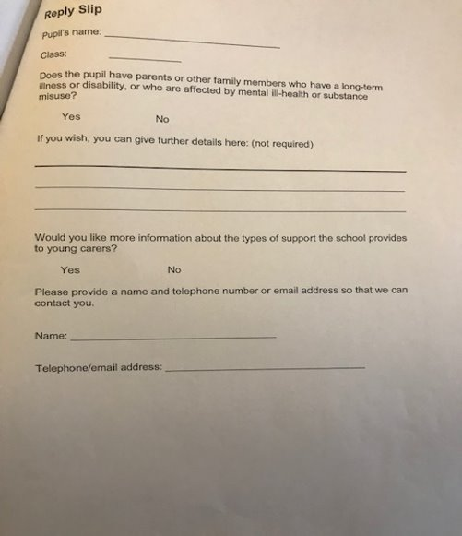
Standard Two - Inform
Letter to Governors to raise awareness of young carers at a meeting
Whole School commitment evidenced by letter home expressing School commitment to Young Carers with reply slip.

Slide 12
IDENTIFY:
Have an informative and comprehensive range of posters showing the impacts, identification and who to signpost to on the staff noticeboard so they are always visible to staff
Having information on the impacts, identification and who to signpost to within the school and externally on the schools shared drive make it accessible at all times for staff

Slide 13
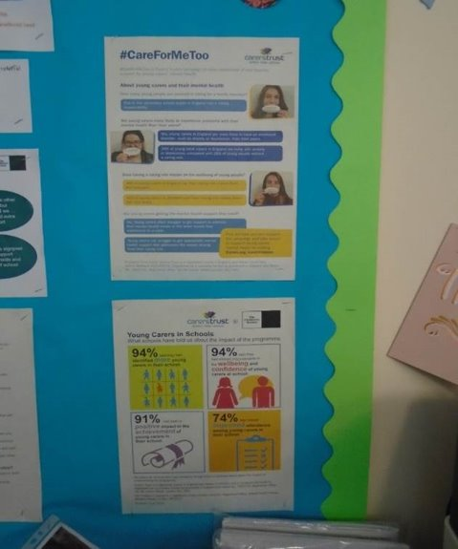
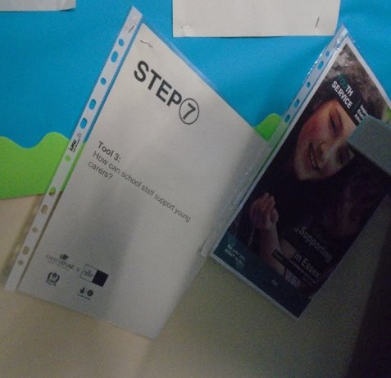
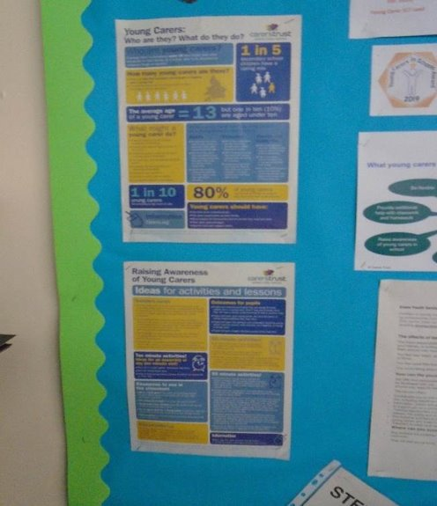
Standard Three - Identify
Staff noticeboard contains information on identification and signposting of young carers

Slide 14
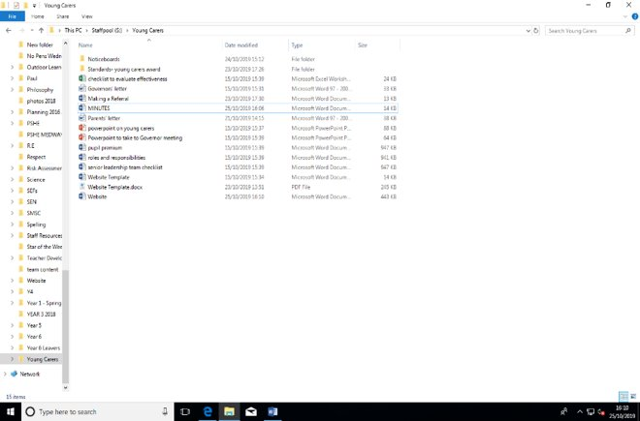
Standard Three - Identify
Screenshot of shared staff drive, folders etc., and close up of signposting on staff noticeboard of the shared drive

Slide 15
LISTEN:
Drop in sessions for young carers
Young Carers group within the school
A communication system for young carers to be able contact the young carer lead confidentially

Slide 16
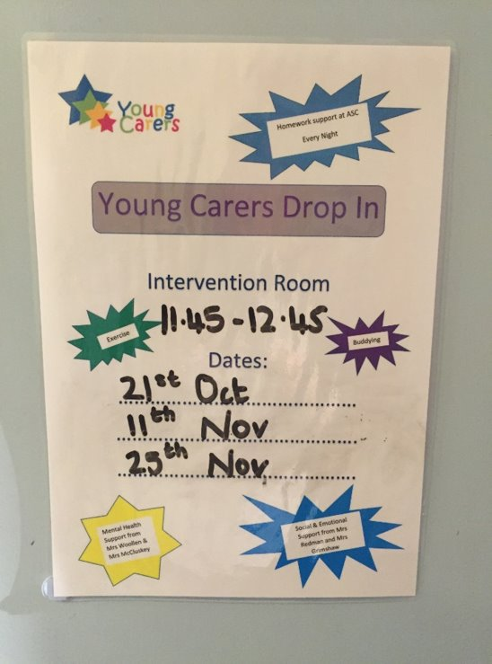
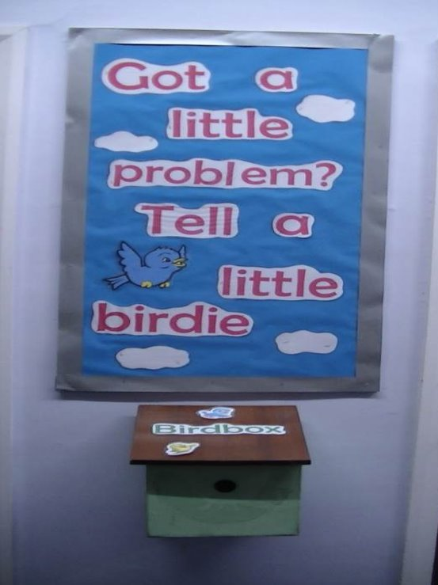
Standard Four - Listen
Evidence of advertised drop-in sessions & system for young carers to message staff​

Slide 17
SUPPORT:
Having support available in the school for young carers around homework/academic support
Advertising outside agencies that can support young carers i.e. the local young carers service
Providing details of wellbeing support or school nurse

Slide 18
Standard Five - Support

Slide 19
The Impact of YCiS Award
“The Young Carers in Schools Programme has enabled us to ensure that the right support is in place for Young Carers. We are now more aware and more able to address their needs.”
Head teacher

Slide 20
The Impact of YCiS Award

Slide 21
Thank you
YCiS@childrenssociety.org.uk
Youngcarersinschools.com

