Slide 1
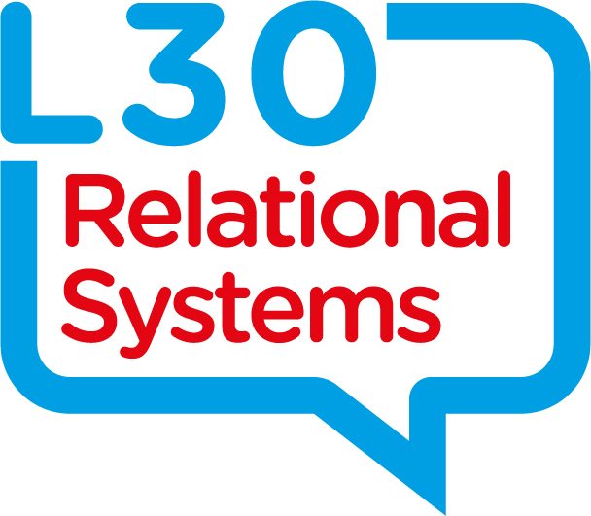
Restorative Practice
The power of relationships and working
WITH
Practice by design and not default
Connect on twitter @markfinnis
www.L30relationalsystems.co.uk

Slide 2



Relationships, Relationships, Relationships
Build, Maintain and Repair

Slide 3
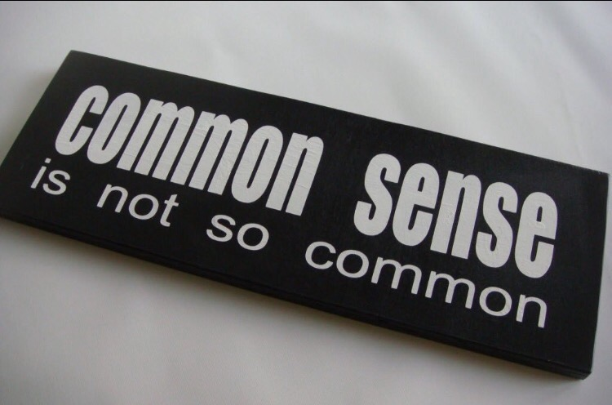
Change requires energy…

Slide 4





Relationship window
To
With
Challenge
Not
For
Support
Adapted from: Wachtel T & McCold P in Strang H & Braithwaite J (eds), (2001),
Restorative Justice and Civil Society, Cambridge University Press, Cambridge
Notes:
SLIDE 11
TIMING: 25 MINUTES
Trainers Notes
11.1 Outcome: To gain greater clarity about communication within relationships and possible effects And introduce working WITH
11.2 Link back to the previous activity and the question ‘What did challenge and support look like’
11.3 Work through with group with what ‘challenge’ and ‘support’ mean. Flip chart responses to really build a picture of what these words mean to group.
11.4 Explain that we are now going to look at four different practice choices in each of the four windows
11.5 Draw a SDW on a flip chart and leave four boxes empty.
11.6 Once social discipline window has been drawn with challenge and support axis – ask the group to following four questions and complete the relevant boxes with the group’s comments:-
If a child is brought up in a family that is really low on challenge and low on support, what might we see happen? Seek examples of the group, and then ask, what might be the outcome for the child?
If a child is brought up in a family that is really high on support but low on challenge, what might we see happen? Seek examples of the group, and then ask, what might be the outcome for the child?
If a child is brought up in a family that is really high on challenge, but low on support, what might we see happen? Seek examples of the group, and then ask, what might be the outcome for the child?
Finally ask if a child is raised in a family that is high on both support and challenge, what might be the outcome for that child?
11.7 After filling in the four boxes with groups responses, then go through the four key words either on the flip chart drawing into the four boxes (TO, FOR, NOT and WITH words) or work through ppt slide and explore the TO,FOR,NOT and WITH boxes reinforcing all key points. Now relate these key words to practice giving personal and practical examples to help bring this to life.
11.8 Now take the copy that you have just drawn up with group off the flip chart and place on the floor. Encourage participants to stand up and explain that the floor has now become a huge SDW and point to the areas on floor that represent the four boxes based around flip chart you have just placed on the floor. Encourage participants to move to the square that they think they practice in most of the time.
11.9 Ask participants some key questions, for example – What is it you do in your practice that makes you think you practice in that particular square of the window?
11.10 Ask the group to get into pairs and discuss the rationale for their practice is and really start to pick this apart in relation to both their work with children and families, but also with in their teams with colleagues. How does this practice relate to building relationship and connections?
11.11 Trainer to reinforce that a ‘TO’ or ‘FOR’ approach is often externally managed by us as professionals and doesn’t encourage CYPF to take responsibility and become accountable for making decisions that affect them either proactively or reactively.
11.12 Trainer to give live examples throughout to help bring WITH to life.
11.13 Before moving on, explain that the model can be used to describe and understand all relationships. Ask the group to consider the different relationships both professional and personal and how we interact from different windows with different people.
Challenge: Rule setting, Boundaries, Expectations, Discipline
Support: Listening, nurturing, Caring, understanding
Example of being in all 4 boxes: Teaching a child to tie their shoes

Slide 5
Relationship window
To
With
Rules
Not
For
Relationships
Adapted from: Wachtel T & McCold P in Strang H & Braithwaite J (eds), (2001),
Restorative Justice and Civil Society, Cambridge University Press, Cambridge
Notes:
SLIDE 11
TIMING: 25 MINUTES
Trainers Notes
11.1 Outcome: To gain greater clarity about communication within relationships and possible effects And introduce working WITH
11.2 Link back to the previous activity and the question ‘What did challenge and support look like’
11.3 Work through with group with what ‘challenge’ and ‘support’ mean. Flip chart responses to really build a picture of what these words mean to group.
11.4 Explain that we are now going to look at four different practice choices in each of the four windows
11.5 Draw a SDW on a flip chart and leave four boxes empty.
11.6 Once social discipline window has been drawn with challenge and support axis – ask the group to following four questions and complete the relevant boxes with the group’s comments:-
If a child is brought up in a family that is really low on challenge and low on support, what might we see happen? Seek examples of the group, and then ask, what might be the outcome for the child?
If a child is brought up in a family that is really high on support but low on challenge, what might we see happen? Seek examples of the group, and then ask, what might be the outcome for the child?
If a child is brought up in a family that is really high on challenge, but low on support, what might we see happen? Seek examples of the group, and then ask, what might be the outcome for the child?
Finally ask if a child is raised in a family that is high on both support and challenge, what might be the outcome for that child?
11.7 After filling in the four boxes with groups responses, then go through the four key words either on the flip chart drawing into the four boxes (TO, FOR, NOT and WITH words) or work through ppt slide and explore the TO,FOR,NOT and WITH boxes reinforcing all key points. Now relate these key words to practice giving personal and practical examples to help bring this to life.
11.8 Now take the copy that you have just drawn up with group off the flip chart and place on the floor. Encourage participants to stand up and explain that the floor has now become a huge SDW and point to the areas on floor that represent the four boxes based around flip chart you have just placed on the floor. Encourage participants to move to the square that they think they practice in most of the time.
11.9 Ask participants some key questions, for example – What is it you do in your practice that makes you think you practice in that particular square of the window?
11.10 Ask the group to get into pairs and discuss the rationale for their practice is and really start to pick this apart in relation to both their work with children and families, but also with in their teams with colleagues. How does this practice relate to building relationship and connections?
11.11 Trainer to reinforce that a ‘TO’ or ‘FOR’ approach is often externally managed by us as professionals and doesn’t encourage CYPF to take responsibility and become accountable for making decisions that affect them either proactively or reactively.
11.12 Trainer to give live examples throughout to help bring WITH to life.
11.13 Before moving on, explain that the model can be used to describe and understand all relationships. Ask the group to consider the different relationships both professional and personal and how we interact from different windows with different people.
Challenge: Rule setting, Boundaries, Expectations, Discipline
Support: Listening, nurturing, Caring, understanding
Example of being in all 4 boxes: Teaching a child to tie their shoes

Slide 6

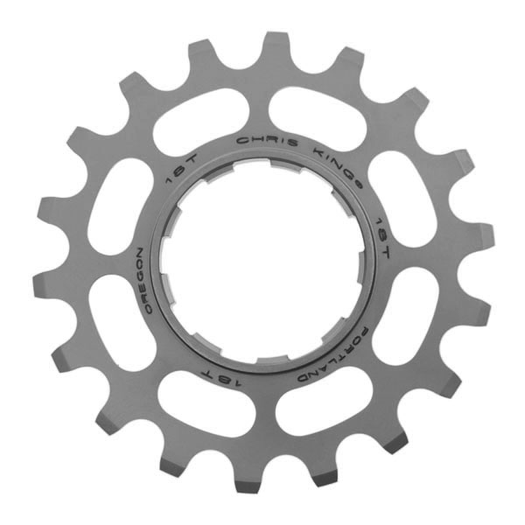


Outcomes
Practice
Skills
Values & Beliefs
Theory
Inspired By B Hopkins and developed by Mark Finnis and Paul Moran 2011
Notes:
SLIDE 9
TIMING: 20 MINUTES
Trainers Notes
9.1 This is a three part flipchart (or discussion) exercise
9.2 Outcome: Articulate how participants day to day practices currently and consistently build and maintain Core Values and Beliefs
9.3 In their smaller groups and ask them to write down their Core values and beliefs. Also, the values and beliefs they try to promote
9.4 When complete, ask them then to consider and write down on the next piece of paper, the skills people need to have in order to develop the values and beliefs they noted previously
9.5 When complete, ask them what day to day activities or practices they are involved in, as part of their work, which allow them and others to express and practice the skills in order to promote the values and beliefs.
9.6 Feedback can be done after each stage but tends to be best done as one go at the end of the exercise.
Examples:
Values & Beliefs: Collaborative Working
Partnership Working
Skills: Communication
Practice: Monthly multi agency meetings
Regular Supervision

Slide 7
Outcomes
Being
Doing
Knowing
Theory
Inspired By B Hopkins and developed by Mark Finnis and Paul Moran 2011
Notes:
SLIDE 9
TIMING: 20 MINUTES
Trainers Notes
9.1 This is a three part flipchart (or discussion) exercise
9.2 Outcome: Articulate how participants day to day practices currently and consistently build and maintain Core Values and Beliefs
9.3 In their smaller groups and ask them to write down their Core values and beliefs. Also, the values and beliefs they try to promote
9.4 When complete, ask them then to consider and write down on the next piece of paper, the skills people need to have in order to develop the values and beliefs they noted previously
9.5 When complete, ask them what day to day activities or practices they are involved in, as part of their work, which allow them and others to express and practice the skills in order to promote the values and beliefs.
9.6 Feedback can be done after each stage but tends to be best done as one go at the end of the exercise.
Examples:
Values & Beliefs: Collaborative Working
Partnership Working
Skills: Communication
Practice: Monthly multi agency meetings
Regular Supervision

Slide 8
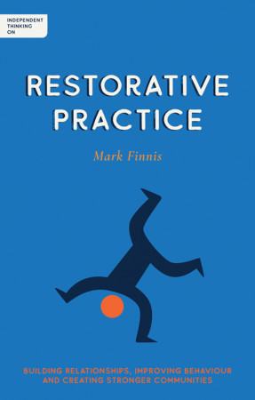

Independent Thinking on Restorative Practice
Building relationships, improving behaviour and creating stronger communities
By Mark Finnis

Slide 9
Twitter @markfinnis
office@L30relationalsystems.co.uk
L30RelationalSystems.co.uk

