Slide 1
Early Years Foundation Stage Profile
Training for Year R
Summer Term 2022
Delivered by the Early Years Advisory Teacher Team
Ella Harbut and Sue Bowler

Slide 2
The EYFS Profile Handbook 2022
Early years foundation stage profile handbook_2022 (publishing.service.gov.uk)

Slide 3
Purpose of the Profile
To support a successful transition to Key Stage 1 by informing the professional dialogue between EYFS and Year 1 teachers
Practitioners are expected to use their professional judgement to make assessments, based on their knowledge and understanding of what the child knows, understands and can do
Information shared with Year 1 colleagues about each child’s stage of development and learning needs should be used to plan the year 1 curriculum to meet the needs of all children.
The EYFS profile is also used to inform parents about their child’s development
The EYFS profile is an end of year summative assessment. It should not be used as a curriculum or for ongoing assessment
Notes:
The profile is still intended to provide a reliable, valid and accurate assessment of each child’s development at the end of the EYFS and is made up of an assessment of the child outcomes in relation to the 17 ELG descriptors

Slide 4
Principles of the Profile
Practitioners using their knowledge of the children: assessment based primarily on the practitioner’s professional knowledge of what the child knows, remembers and can do day to day. It is a means of checking whether the child has learnt what has been taught or can take place during routine interactions with children and does not need to be planned or documented.
Summative: assessment is based on a holistic view of what the child can demonstrate against each ELG at the end of the reception year.
Informed by a range of perspectives
Inclusive
Underpinned by a broad curriculum and effective pedagogy
Notes:
Reliable and accurate assessment at the end of the EYFS is
The practitioner may simply reflect on the knowledge, skills and understanding that the child demonstrates in the course of everyday learning to plan what to teach next. Where something has been well taught a child’s learning is embedded and secure and the child is likely to demonstrate what they know and can do consistently in a range of situations.
When assessing children against the ELGs, teachers should look at the whole description for each goal to determine whether this best fits their professional knowledge of the child. The ELGs are interconnected, meaning that children demonstrate attainment in more than one area of learning when engaging in a particular activity. Practitioners should consider the child’s development across the areas of learning, and whether the levels of development in relation to each of the goals make sense when taken together.
assessment is predominantly based on the teacher’s professional judgement but should also take account of contributions from a range of perspectives (parents, other adults)
practitioners need to be alert to the general diversity of children’s interests, needs and backgrounds, in order to accurately assess their development and outcomes against the ELGs. This includes children with a special educational need or disability (SEND), who may demonstrate their attainment in different ways. Children whose home language is not English should have opportunities to engage in activities in the security of their home language. Children from different cultural backgrounds will demonstrate their attainment not only through what they have been taught but also when activities such as role play, cookery, celebrations, visits or events are linked to their cultural experience.
teaching should enable each child to demonstrate their learning and development fully. Effective assessment takes place when children are taught well and can talk about what they know, demonstrating their learning and development in a range of contexts. The ELGs represent a narrow measure of what is assessed at the end of reception year and should not restrict the breadth of what is taught in the final year of the EYFS. It is for schools to determine their pedagogical approach and curriculum (having regard for the ‘Educational Programmes’ set out in the EYFS framework) to support children’s learning and development.

Slide 5
Over the course of the reception year, teachers should plan what it is they want children to learn, and build their knowledge of what each child knows and can do. They should draw on this knowledge and their own expert professional judgement to make an accurate summative assessment at the end of the year. This is sufficient evidence to assess a child’s individual level of development in relation to each of the ELGs. Teachers are not expected to provide proof of the child’s level of development using physical evidence. Teachers should not record evidence.
2.3 EYFS Profile Handbook

Slide 6
Schools should not include burdensome evidence gathering requirements against any of the areas of learning in their assessment policies so that teachers and practitioners can spend as much time as possible interacting with children and directly supporting their learning and development. However, teachers may find it helpful to record, in a simple way, particularly noteworthy achievements, such as what phonemes and numbers a child has learned, in order to determine what to teach next. This is sufficient to make a judgement. Sources of written or photographic evidence are not required and teachers should not record evidence.

Slide 7
Completion of the Profile
Assessment must take place in the summer term of the academic year in which a child reaches age 5
You must assess each child against the 17 ELGs and you may choose to provide a commentary on the 3 characteristics of effective learning
Under the revised framework, pupils can only be assessed as Emerging (1) where they have not yet reached the expected level or Expected (2) meeting the level of development expected at the end of the EYFS for each of the 17 Early Learning Goals
There is NO Exceeding judgement this year
Notes:
The exceeding descriptor has been removed and you do not need to record a child as exceeding, but you will obviously still have children whose L&D goes beyond what is described in the ELG descriptor and you will of course be supporting and moving learning forwards for those children through your high quality curriculum. And you will need to describe to Yr 1 teachers how that child is demonstrating their learning.

Slide 8
“The ELGs are based on typical child development at the age of 5, so most children are likely to meet the ‘expected’ level of development. Teachers should use their professional knowledge of the child to decide whether each ELG description best fits the child’s learning and development”
Pg 10 EYFS Profile Handbook
Best-fit does not mean equal mastery of all aspects of the ELG
Notes:
Still using a best fit model and you are required to consider the whole of each ELG description. But remember that best fit does not mean equal mastery of all aspects of the ELG. Each ELG descriptor is written in bullet point form, this is for presentational purposes only and to aid clarity – do not tick off bullet points one by one. You should use your professional judgement to determine whether each ELG in its totality best fts the child’s learning and development – so as we used to, continue to take a holistic view of the descriptor
When considering SEND – take care to ensure the child is able to demonstrate their learning and attainment. Ch should be assessed on the basis of what they can do when using the adaptations, they normally use e.g. mobility aids, adapted ICT etc
And a reminder that a child can use their preferred mode of communication for all ELGs except speaking.
Where a child has a special educational need, teachers should be alert to identifying the child’s attainment and development in a variety of ways, including eye pointing, use of symbols, or signs. In this case, practitioners should give additional detail about the child’s understanding and preferred means of communication in their EYFS profile record. The profile recognises and values linguistic diversity and is inclusive of children whose home language is not English. The ELGs for communication and language, and for literacy, must be assessed in relation to the child’s competency in English. However, the remaining ELGs may be assessed in the context of any language. In such cases teachers will need to observe the child over time and seek input from the parents, and/or bilingual support assistants, to be confident about what the child knows and understands. Teachers should use their professional judgement to consider whether the accounts provided are consistent with their professional knowledge of the child. Other teachers as well as parents/carers should be consulted to aid with this.

Slide 9
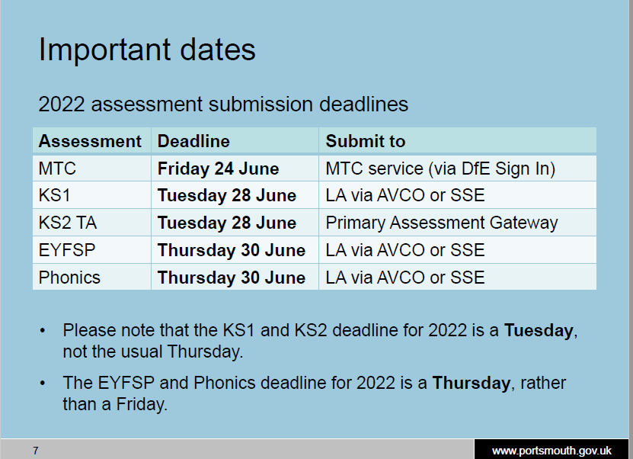
Data Submission
Deadline submission date to the LA is THURSDAY 30th JUNE 2022
Submit via AVCO or SSE
education.informationservices@portsmouthcc.gov.uk
Notes:
Data team advise you to submit the week before the deadline or if you think you will have difficulty in submitting for the deadline, to contact the data team ASAP
We as an LA have to submit the city’s data to the DFE by 29th July, an earlier submission than in previous years (previously end of Aug)

Slide 10
What will the data submission look like?
You need to submit Profile scores for all children for the curriculum year they are being taught in e.g. if a child has deferred entry into Yr R, they need to have the profile completed in Yr R
If a child starts a new school on the first day of the second half of the summer term (or any time after that), then the previous school should submit the data.
If a child moves school any time before the half term, then the new school should submit the data.
Where half term dates differ between LA areas, it is the school where a child attends (or will attend) for the longest period of time that submits the data.
Notes:
This means the average points per goal and the average total points could look very different to previous years –pupils used to be able to score a maximum of 51 points (exceeding in all 17 goals) but will now only be able to score a maximum of 34 points (expected in all 17 goals).
Pgs 17-19 in the handbook have a table setting out the requirements for submission of profile data and contextual child data to LA and also more info on children who remain in eyfs provision beyond age of 5.
Section 5.3 pg 22 of handbook gives the info in the slide regarding children moving from school to school

Slide 11
Responsibilities
LAs must collect EYFS profile data, quality assure and submit to the DfE
Headteachers have a duty to implement the EYFS. They must check to ensure that the data accurately reflects the outcomes of the current cohort of children
Headteachers must ensure parents are provided with a written report of the child’s development against the ELGs and have the opportunity to discuss the EYFS profile
Notes:
Pg 20 details the responsibilities of head teachers, we have just summarised here

Slide 12
Reporting the EYFS profile assessment
At the end of the final year of the EYFS, reception teachers must give year 1 teachers a copy of each child’s EYFS profile, including: a record of the child’s outcomes against the 17 ELGs, stating for each ELG whether the child is: - meeting ‘expected’ levels or - not yet reaching expected levels (‘emerging’) They may choose to provide a short commentary on how the child demonstrates the three characteristics of effective learning.
EYFS teachers are not required or expected to produce any written reports for year 1 teachers beyond these basic requirements. It is, however, crucial that EYFS teachers and year 1 teachers are given sufficient time to discuss and expand on all the information presented in the EYFS profile, in order to give the year 1 teacher a fully rounded picture of the development of each child. In cases where children have an outcome at the ‘emerging’ level, teachers should provide additional information to help the year 1 teacher plan an effective curriculum. This should include information about any specific assessment or provision in place for children with SEND
Notes:
The primary purpose of the EYFS profile assessment is to support a successful transition from the EYFS to year 1.

Slide 13
A Good Level of Development (GLD)
Children are defined as having reached a Good Level of Development at the end of the EYFS if they have achieved the expected level for the ELGs in the prime areas of learning and the specific areas of mathematics and literacy
This helps teachers and parents to understand broadly what a child can do in relation to national expectations
Notes:
Reminder that some children with SEND inc complex SEND needs will potentially achieve some ELGs. But might be assessed as emerging for areas where their specific condition has an impact on their L&D. therefore they might not achieve GLD.

Slide 14
SEND
Further resources for teachers working with children with SEND
Early Years | Nasen
Whole School SEND Home Page | Whole School SEND
Guidance – Section 3.6 – EYFS Profile Handbook

Slide 15
Fact or Fiction?
Fiction | Fact
Reception teachers should be tracking against the ELGs throughout the year | The EYFS profile is an end of Year R health check to demonstrate how a child has achieved against the ELGs
Children need to be reading yellow book band texts to achieve the ELGs for reading | To make a judgement you should look at the ELG descriptor and consider if it is a ‘best fit’ to describe what the child has achieved
The LA no longer moderates all schools, so you don’t have to share the data with them | You can still access moderation support
Teachers should collect evidence for each ELG through the year so they can justify their judgements when completing the profile | You do not have to record evidence to demonstrate a child’s learning
You can make up your own exemplification materials | You don’t have to report the 3 COEL, but you may choose to
Children cannot achieve the literacy ELGs if they do not write a full paragraph which is correctly punctuated

Slide 16
When completing the EYFSP, teachers should use only the ELG descriptors to assess whether or not a child has met the expected level of development. Teachers must not assess against additional elements that are not set out in the ELG descriptor for the purposes of completing the EYFSP.
Taken from DfE letter dates 8th March 2022
Notes:
e.g. book bands!!
On a similar theme interesting comments came up in the EA facebook page a while ago relating to writing.– so the question was “ In DM in literacy it refers to children in reception learning to write short sentences using a CL and FS. But the ELG does not mention this, instead saying write simple sentences that can be read by others – so here is the question – what do you expect?
This could impact on whether you give writing ELG or not! You NEED to asses against the ELG and nothing else. ELG does not refer to punctuation, so you children DO NOT need to be using it to be expected.
Ultimately the DM is non stat guidance, the ELG is statutory – you must judge against the ELG and that does not refer to FS, CL. DM is a curriculum guide and at the end of Yr R you are not assessing against your curriculum you are assessing against the ELGs. You will probably be teaching punctuation, in the way that you model during shared writing, and some children may be using punctuation, but that is not the general expectation of a 5 yr old. The ELGs are where you would like the ch to be at end of yr and are best fit.

Slide 17
DfE and Ofsted are clear that the EYFSP is not an accountability measure for teachers, for schools or for the LA and should not be used in this way
Its purpose is to give a holistic view of child development at the end of the EYFS, and to support a child’s transition into key stage 1 by encouraging professional judgement
Data will still be collected to give an overall picture of child development at a national and local level, to inform policy decisions and research
EYFSP assessment is being described as a low stakes assessment
“Teachers are in the best position to assess their children. We trust the professional judgement of teachers to accurately complete the profile and report their data”
Taken from recent DfE slides LA spring term regional events
Notes:
DfE letter dated 8.3.22 to LAs: We have also been clear that the EYFSP should be regarded as a short and low stakes assessment carried out at the end of reception year with the primary purpose of supporting children’s successful transition into year 1, as well as sharing important information with parents and carers. It should not be used to hold individual teachers, schools or trusts to account. We have also heard examples of LA teams being held to account on the GLD in their local area and we are clear that this is not an appropriate use of the data.
So the profile is a low stakes assessment – it is not publically reported on a school by school basis and not published. The data collection will give some national info e.g. boys girls disadvantaged ethnicity data summer born,

Slide 18
Video exemplification materials
Early Years Foundation Stage videos – YouTube
7 new videos which demonstrate the kinds of conversations that Year R practitioners will be having across the country to describe children’s achievement in relation to the new Early Learning Goals
Vodcast link – this explains the changes to the EYFSP and what is different this year Exemplification materials for schools | From pregnancy to children aged 5 (foundationyears.org.uk)
EYFS supporting information for case study videos (publishing.service.gov.uk)
Notes:
The videos show how practitioners can draw on their knowledge of each child and their own professional judgement to make an accurate summative assessment at the end of the year and include a combination of children who have met and not met the expected levels of development across the ELGs
The seven case study videos show teachers, leaders and support staff having professional discussions about an individual child’s holistic development children’s development and their EYFSP judgements. The videos were filmed in early adopter schools from across the country who volunteered to share their experiences assessing against the new ELGs last year. The teachers demonstrate behaviour that is in line with government guidance following the EYFS reforms, including using professional judgement and knowledge of individual children to make assessments, as opposed to collecting physical evidence to support moderation discussions.
The exemplification videos aim to empower teachers to approach the new EYFSP feeling trusted in their professional judgements and confident that they will not be externally checked for accuracy or held to account on the EYFSP scores of children in their class. They are not designed to be used for curriculum planning or to provide an exhaustive list of things that will contribute to a teacher’s decision that a child has, or has not, reached the expected level of development. Development Matters supports curriculum planning under the revised EYFS framework. Other information and support is available on Help for Early Years Providers and Foundation Years.
Context note to go with videos – not designed to be a curriculum planning resource and a reminder that ELGs are not curriculum, you must provide ad broad curriculum across 7 AOL. In the videos you see discussions that cover a number of AOL which serves to demo that the profile is a holistic tool.
Due to the pandemic the videos were filmed in EA sch in autumn term, so the classroom footage of ch is not representative of what ch would actually be doing to achieve ELG at end of yr, so the footage is for aesthetic purposes only
The videos demo ways in which teachers come to make their judgments, often through discussion with others, you do not need to replicate these conversations in your schools for every child in your class
WATCH several of videos – merits and challenges of the videos??

Slide 19
Early Years Foundation Stage: Exemplification materials - Case Study 4 – YouTube
Early Years Foundation Stage: Exemplification materials - Case Study 7 – YouTube
Early Years Foundation Stage: Exemplification materials - Case Study 2 - YouTube
Notes:
4 – expected C&L and EAD
7 – emerging for self reg and expected for UTW
2 – expected for C&L and maths

Slide 20
Prime Areas – Communication and Language
Listening, Attention and Understanding ELG
Children at the expected level of development will:
- Listen attentively and respond to what they hear with relevant questions, comments and actions when being read to and during whole class discussions and small group interactions; - Make comments about what they have heard and ask questions to clarify their understanding; - Hold conversation when engaged in back-and-forth exchanges with their teacher and peers.
Speaking ELG
Children at the expected level of development will:
- Participate in small group, class and one-to-one discussions, offering their own ideas, using recently introduced vocabulary; - Offer explanations for why things might happen, making use of recently introduced vocabulary from stories, non-fiction, rhymes and poems when appropriate; - Express their ideas and feelings about their experiences using full sentences, including use of past, present, and future tenses and making use of conjunctions, with modelling and support from their teacher.
Notes:
Read these ELGs– think about how they fit with typical child development, consider our expectations for 5 yr olds – this is the national expectation in the ELG and the handbook states that most ch will be expected
How do you use your prof knowledge of the child?

Slide 21
Prime Areas - PSED
Self-Regulation ELG
Show an understanding of their own feelings and those of others, and begin to regulate their behaviour accordingly; - Set and work towards simple goals, being able to wait for what they want and control their immediate impulses when appropriate; - Give focused attention to what the teacher says, responding appropriately even when engaged in activity, and show an ability to follow instructions involving several ideas or actions.
Managing Self ELG
Be confident to try new activities and show independence, resilience and perseverance in the face of challenge; - Explain the reasons for rules, know right from wrong and try to behave accordingly; - Manage their own basic hygiene and personal needs, including dressing, going to the toilet, and understanding the importance of healthy food choices.
Building Relationships ELG
Work and play cooperatively and take turns with others; - Form positive attachments to adults and friendships with peers; Show sensitivity to their own and to others’ needs.
Notes:
As we read these out, think of your class. Think of children who you are not sure about meeting the expectation. We will have opportunity to discuss them later

Slide 22
Prime Areas – PSED and CL
Finn manages emotions - Siren Films
Watch the clip and discuss. Do you think Finn was demonstrating learning at the expected level of development at the end of Year R for the following ELGs:
Listening and Attention
Speaking
Self-regulation
Notes:
These are NOT exemplification materials.
These are examples of children learning and playing in a year R context they may or may not be demonstrating the ELGs but these should provoke some conversation about skills demonstrated and are only being used for the purpose of showing skills of children in certain AOL.

Slide 23
Prime Areas – Physical Development
Gross Motor Skills ELG
Children at the expected level of development will:
- Negotiate space and obstacles safely, with consideration for themselves and others; - Demonstrate strength, balance and coordination when playing; - Move energetically, such as running, jumping, dancing, hopping, skipping and climbing.
Fine Motor Skills ELG
Children at the expected level of development will:
- Hold a pencil effectively in preparation for fluent writing – using the tripod grip in almost all cases; - Use a range of small tools, including scissors, paint brushes and cutlery; - Begin to show accuracy and care when drawing.

Slide 24
Prime Areas - PD
Tyre balancing - Siren Films
Types of play - co-operative - physical - Siren Films
Anna and Sky play high school kung fu - Siren Films
As you watch each of these clips write down on the post it notes words to describe what the child/children are doing which you think fit with the ELG descriptor
Notes:
These are NOT exemplification materials.
These are examples of children learning and playing in a year R context they may or may not be demonstrating the ELGs but these should provoke some conversation about skills demonstrated
Don’t forget that you would be making a decision about whether the child has achieved the ELG not on one example alone, as they don’t necessarily show the breadth of the ELG. But also remember that we are not looking for equal mastery of the ELG.
And remember as stated in the handbook, most children will be expected for the ELGs. Don’t read too much into the goal, the aim is to match the descriptor to the skills shown by ch you are assessing

Slide 25
Overall Observations
Building a path - Siren Films
Reflect on any area of learning demonstrated and refer back to the ELGs. Are any of these children are demonstrating the expected level of development for the area you are focusing on?
Notes:
10 ins 16

Slide 26
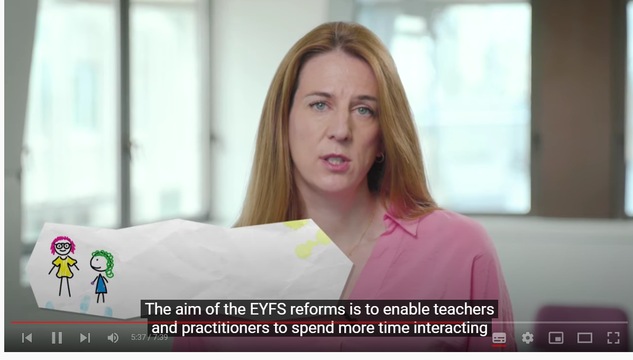
Chapter 1 – Curriculum and the EYFS Profile under the new EYFS - YouTube
Notes:
7 min 39
Susie Owen Director of EY and Childcare at the DfE and Phil Minns talking about Ofsted’s view of the curriculum in the ETY
Do you want to watch? Have you seen? This supports other staff members to understand the revisions and the implications for inspection and completion of the profile. If you are challenged by SLT this is a vodcast to share

Slide 27
What is moderation like for you now?
Schools should decide on their own individual approach to moderation
Collaborative process with colleagues
Supporting quality assurance of teacher assessment
CPD opportunity
Does not mean you have to collect or record evidence, it is about peer-to-peer moderation conversations
Discussion Point
Share your best moderation practice with others
How do you moderate, who do you moderate with, when do you moderate?
What would make it even better? Would you like any further external support?
What form should this take?

Slide 28
Further Support
Ella.harbut@portsmouthcc.gov.uk
Sue.bowler@portsmouthcc.gov.uk
EYFS Managers in Schools Cluster – 14th June 4-5pm (please note change of date if you had already booked a place)

Slide 29
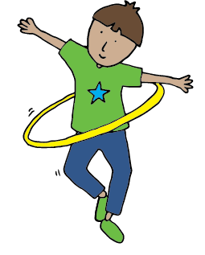
New for 2022…
Core Package - £395
5 virtual workshops
Access to video library (15 titles)
4 Bitesize virtual workshops (choice of either new to EYFS or communication and language)
Build Your Own Package - individually priced
2 hour virtual workshops - £65
2 hour Early Years Officer visit - £100
3 hour onsite PSCP training for staff teams - £170
2 hour onsite training for staff teams - £200
Each 1 hour bitesize new to the EYFS virtual workshop - £45 or all 4 for £150
Each 1 hour bitesize communication and language virtual workshop - £45 or all 4 for £150
2 hour experience workshops (face to face) - £100
Enhanced Package - £675
5 virtual workshops
2 hour Early Years Officer visit
3 hour onsite PSCP training for staff teams
2 hour onsite training for staff teams
4 Bitesize new to EYFS virtual workshops
4 Bitesize communication and language virtual workshops
Access to video library

Slide 30
Professional Discussions
Mix with other schools and share your judgements and engage in professional dialogue about your cohorts
Raise ELGs you have looked at and want further clarification on
Raise (anonymised children) and discuss learning that you think demonstrates the expected level or that you think is emerging
Raise (anonymised children) and discuss learning that is ‘stuck’ – what can you do to move this on?

