Slide 1
LA Headteachers breakfast briefing. 16th September 2019

Slide 2
Headteacher appointments and new arrangements from Sept 2019
Matthew McLoughlin-Parker, Interim Headteacher, The Harbour School
Helen Castle, Headteacher, Manor Infant School
Ashley Howard, Headteacher, Highbury Primary Academy
Rob Jones, Headteacher, Stamshaw Junior Academy
Paul Langston, Interim Head, Westover Primary School
Gemma Comerford, Interim Head, Corpus Christi Catholic Primary School
Debbie Anderson, Executive Head, Northern Parade Schools

Slide 3
Headteacher appointments and new arrangements from Sept 2019
Emma Morey, Interim Principal, Charter Academy
Rachel Grey, Principal, The Portsmouth Academy
Jim Hartley, Executive Head, Victory and Beacon View Primary Academies
Rebecca Mitchell, Head of School, Beacon View Primary Academy
Kath Jones, Head of School, Victory Primary Academy
Sonia Nickerson & Christine Turner, sharing Head of School, Moorings Way Infant School. Sonia is the Executive Head across Moorings Way Infant and Meon Infant & Junior Schools

Slide 4
Children’s Social Care
Sarah Daly – Deputy Director
Email: sarah.daly@portsmouthcc.gov.uk
Telephone: 023 9284 1154

Slide 5
Structure – SMT
Sarah Daly
Deputy Director
Tel: 023 9284 1154
Adam Shepherd
Assessment & Intervention Service
Tel: 023 9243 7671
Denise Lingham
Safeguarding Monitoring
Tel: 023 9243 7670
Kate Freeman
Looked After Children
Tel: 023 9283 4652
Bruce Marr
Harm and Exploitation
Tel: 023 9268 8569

Slide 6
Service Areas
MASH
Assessment & Intervention
Looked After Children
Safeguarding Monitoring
Harm and Exploitation

Slide 7
Activity level in CSC
Number of referrals – 262 (July)
Assessments completed – 232 (July)
Children on a CP Plan – 175 (July)
Looked After Children – 481 (95 UAM)
69 children at risk of CSE - 8 high, 18 medium and 43 low
64 children at risk of CE - 11 high, 23 medium and 31 low

Slide 8
Practice Framework
Stronger Futures 11
Restorative Practice
Family Safeguarding Model
Trauma Informed Model of Care
Mockingbird
Reunification

Slide 9
Provisional Results 2019 Attainment across all key stages + latest update on school absence and exclusions Mike Stoneman Deputy Director, Education & Early Help Children, Families and Education, PCC

Slide 10
Data sources
2019 data is provisional/estimated for all key stages
National results 2019 for EYFS, Phonics and Key Stage 1 use NCER proxy data
2019 Key Stage 2 results use provisional data published by the DfE on 9th July
2019 Key Stage 4 results are based on headline estimates provided by schools in August

Slide 11
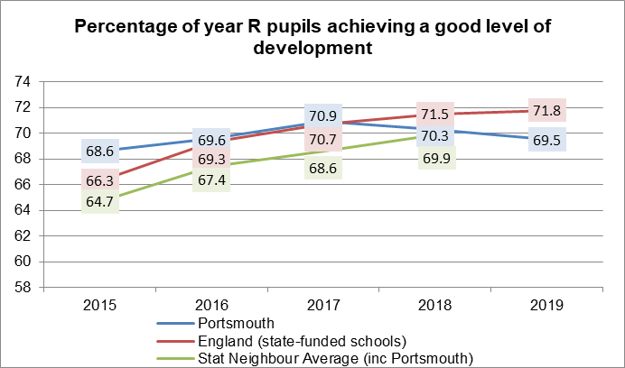
EYFS – % GLD
69.5% of year R pupils in Portsmouth achieved a good level of development in 2019, a decrease of 0.8 percentage points compared to 2018
National results improved slightly, so the gap to national has increased to 2.3 % points

Slide 12
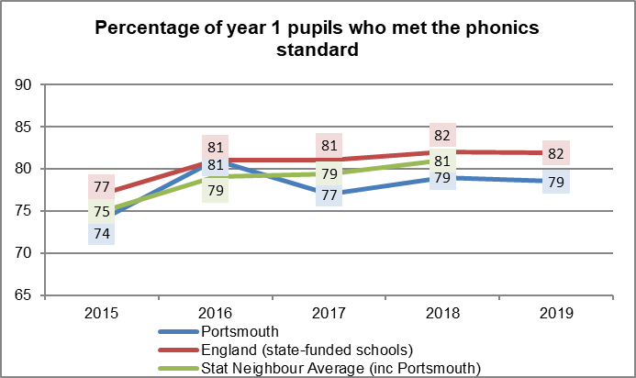
Phonics
79% of year 1 pupils in Portsmouth met the phonics standard in 2019, the same as in 2018
National results have also stayed the same, so the gap to national remains at 3 % points

Slide 13
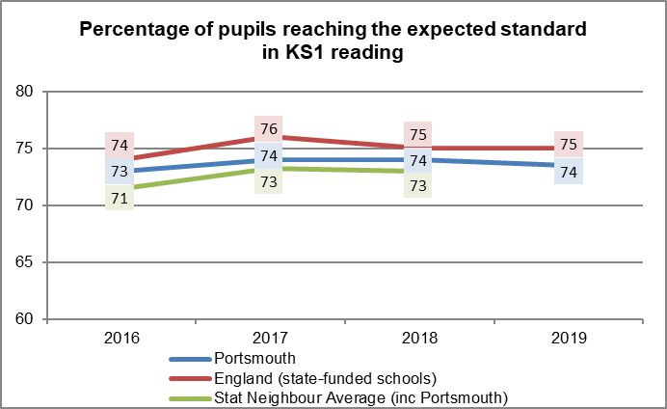
Key Stage 1 - Reading
74% of KS1 pupils in Portsmouth reached the expected standard in reading in 2019, the same as in 2018
National results also stayed the same, so the gap to national remains at 1 % point

Slide 14
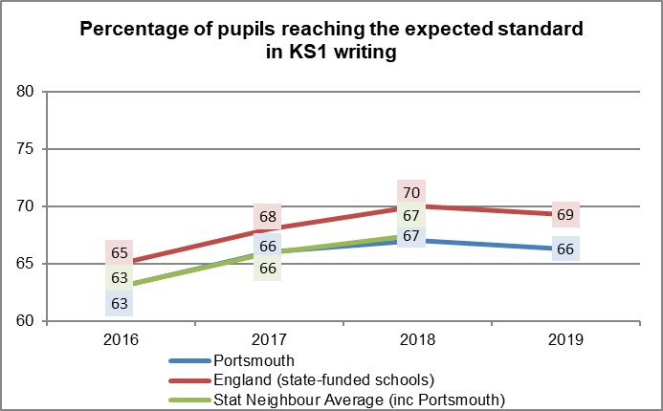
Key Stage 1 - Writing
66% of KS1 pupils in Portsmouth reached the expected standard in writing in 2019, a decrease of 1 percentage point compared to 2018
Nationally, results have also decreased by 1 % point, meaning the gap to national remains at 3 % points

Slide 15
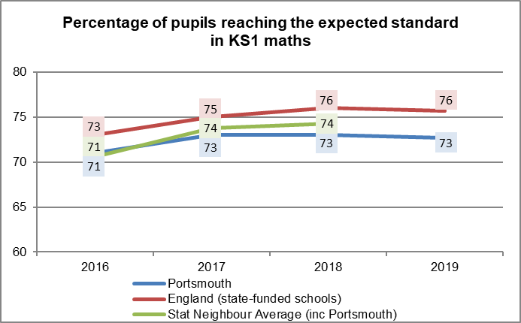
Key Stage 1 - Maths
73% of KS1 pupils in Portsmouth reached the expected standard in maths in 2019, the same as in 2018
Nationally, results have also stayed the same, so the gap to national remains at 3 % points

Slide 16
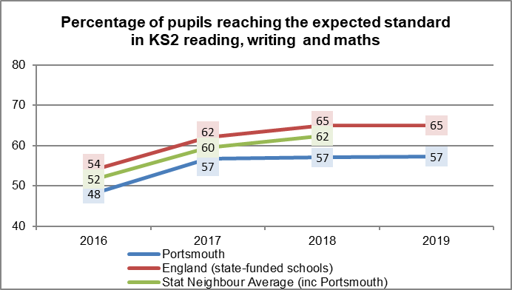
Key Stage 2 - RWM
57% of KS2 pupils in Portsmouth reached the expected standard in reading, writing and maths in 2019, the same proportion as in 2018
Nationally there has also been no change, meaning the gap remains the same at 8 % points

Slide 17
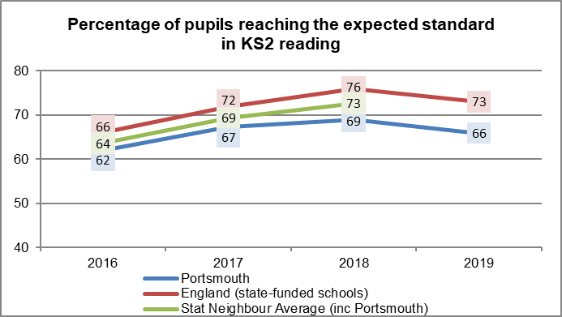
Key Stage 2 - Reading
66% of KS2 pupils in Portsmouth reached the expected standard in reading in 2019, a decrease of 3 percentage points compared to 2018
Nationally there has also been a decrease of 3 points, so the gap to national remains the same at 7 % points

Slide 18
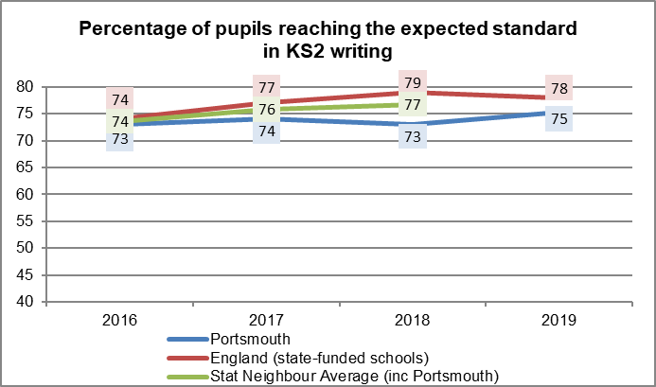
Key Stage 2 - Writing
75% of KS2 pupils in Portsmouth reached the expected standard in writing in 2019, an increase of 2 percentage points compared to 2018
Nationally there has been a decrease of 1 point, so the gap to national has reduced to 3 % points

Slide 19
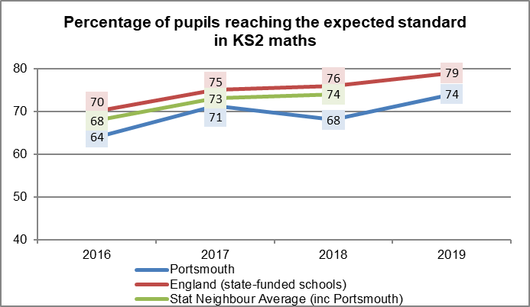
Key Stage 2 - Maths
74% of KS2 pupils in Portsmouth reached the expected standard in maths in 2019, an increase of 6 percentage points compared to 2018
Nationally there has been an increase of 3 points, so the gap to national has reduced to 5 % points

Slide 20
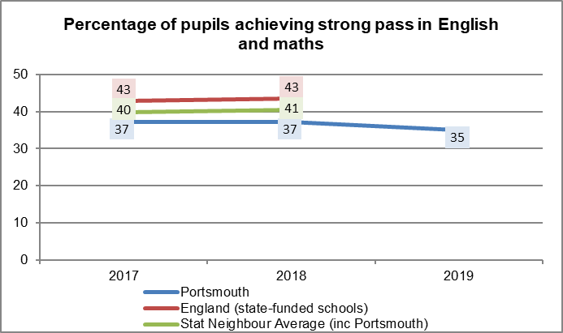
Key Stage 4 - E&M Strong Pass
35% of pupils in Portsmouth achieved a strong pass (grades 9-5) in English and maths in 2019, a decrease of 2 percentage points compared to 2018

Slide 21
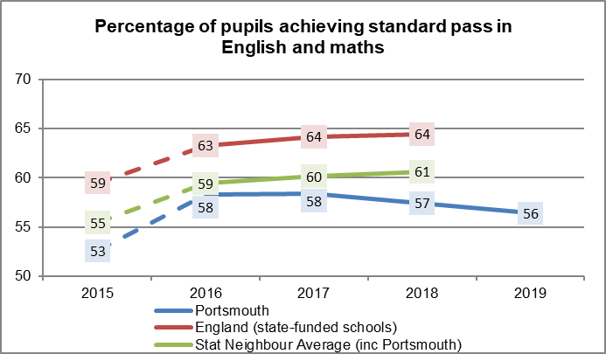
Key Stage 4 - E&M Standard Pass
56% of pupils in Portsmouth achieved a standard pass* in English and maths in 2019, a decrease of 1 percentage point compared to 2018
* Grades 9-4 from 2017, A*-C prior to 2017

Slide 22
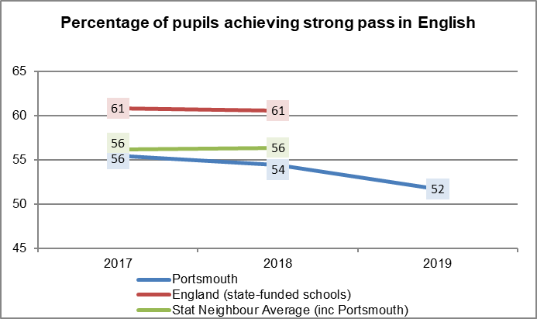
Key Stage 4 - English Strong Pass
52% of pupils in Portsmouth achieved a strong pass in English in 2019, a decrease of 2 percentage points compared to 2018

Slide 23
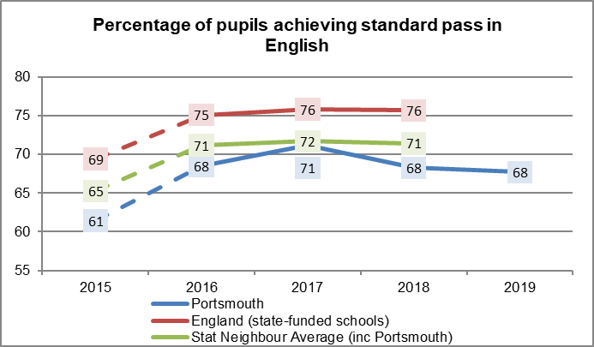
Key Stage 4 - English Standard Pass
68% of pupils in Portsmouth achieved a standard pass in English in 2019, the same as in 2018

Slide 24
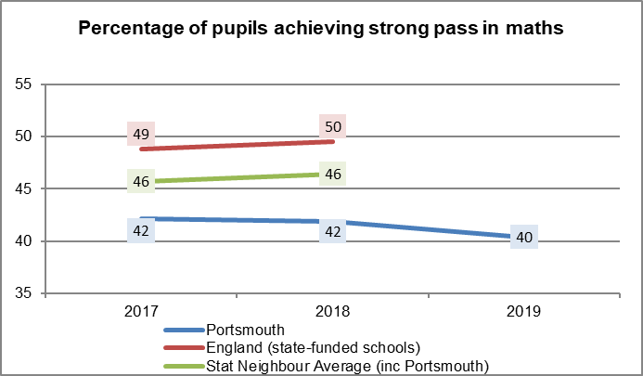
Key Stage 4 - Maths Strong Pass
40% of pupils in Portsmouth achieved a strong pass in maths in 2019, a decrease of 2 percentage points compared to 2018

Slide 25
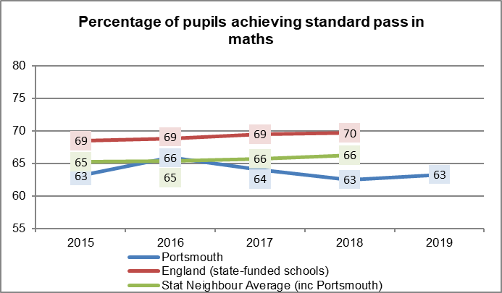
Key Stage 4 - Maths Standard Pass
63% of pupils in Portsmouth achieved a standard pass in maths in 2018, the same as in 2018

Slide 26
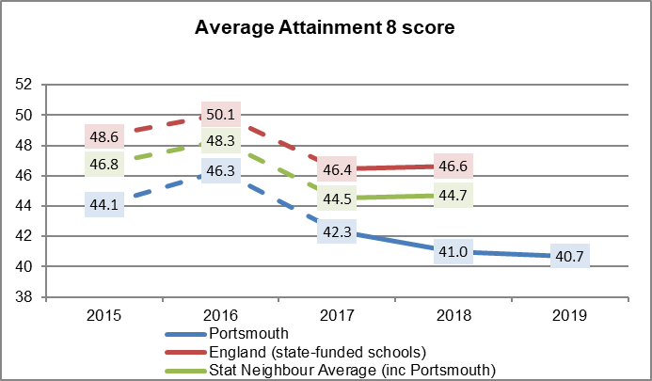
Key Stage 4 - Attainment 8
Portsmouth pupils achieved an average Attainment 8 score of 40.7 in 2019, a decrease of 0.3 compared to 2018
NOTE: Attainment 8 scores are not directly comparable prior to 2017 due to changes in methodology

Slide 27
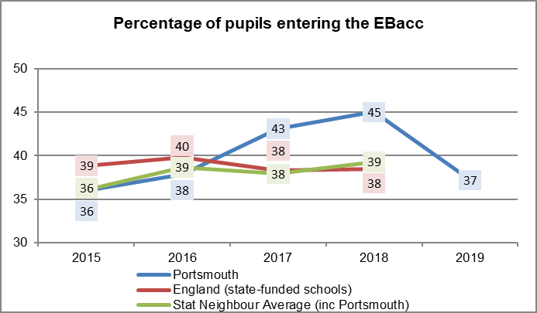
Key Stage 4 - Ebacc Entries
37% of pupils in Portsmouth entered the EBacc in 2019, a decrease of 8 percentage points compared to 2018

Slide 28
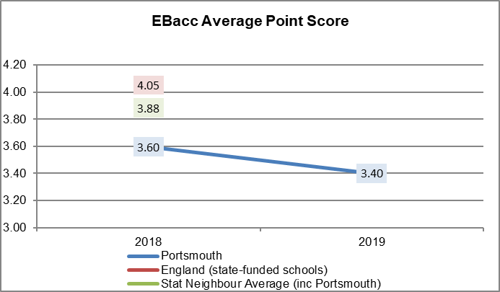
Key Stage 4 - Ebacc APS
Pupils in Portsmouth had an EBacc average point score of 3.40 in 2019, which is a decrease of 0.2 points compared to 2018

Slide 29
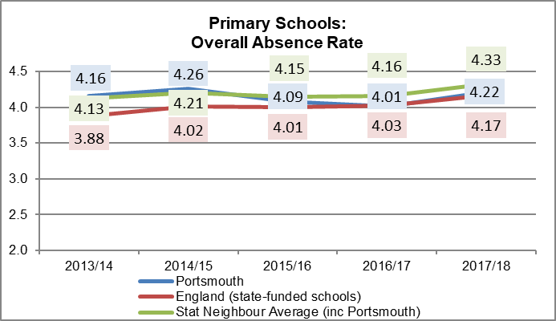
Absence - Primary Overall Absence
The overall absence rate in Portsmouth primary schools was 4.22% of sessions missed in 2017/18, an increase of 0.21 percentage points from the previous year
The overall absence rate in Portsmouth primary schools is slightly above national and below the statistical neighbour average

Slide 30
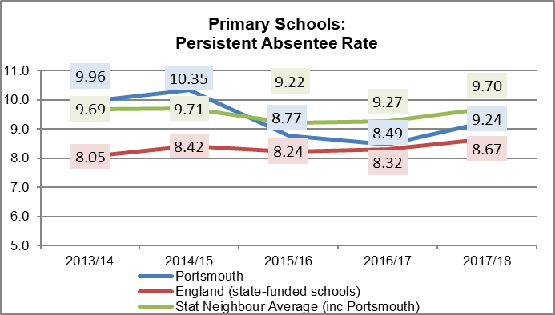
Absence - Primary Persistent Absence
The persistent absentee rate in Portsmouth primary schools was 9.24% of enrolments in 2017/18, an increase of 0.75 percentage points from last year
The persistent absentee rate in Portsmouth primary schools is above national and below the statistical neighbour average

Slide 31
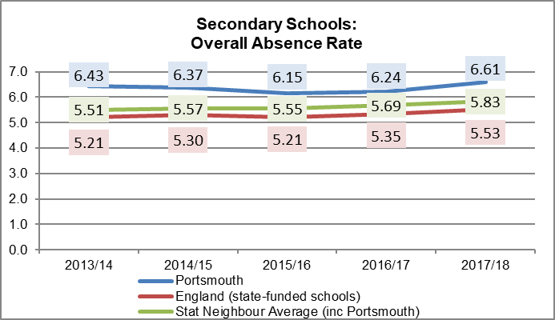
Absence - Secondary Overall Absence
The overall absence rate in Portsmouth secondary schools was 6.61% of sessions missed in 2017/18, an increase of 0.37 percentage points from the previous year
The overall absence rate in Portsmouth secondary schools is 1.08 percentage points above national and 0.78 points above the statistical neighbour average

Slide 32
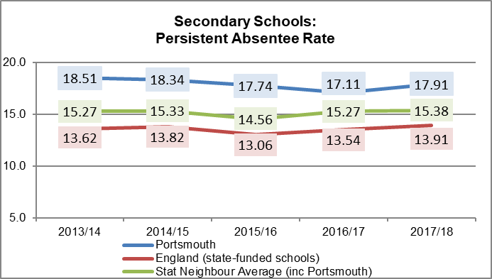
Absence - Secondary Persistent Absence
The persistent absentee rate in Portsmouth secondary schools was 17.91% of enrolments in 2017/18, an increase of 0.8 percentage points from last year
The persistent absentee rate in Portsmouth secondary schools is 4 percentage points above national and 2.53 points above the statistical neighbour average

Slide 33
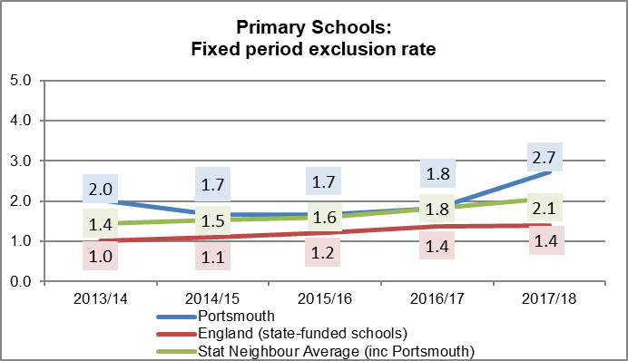
Fixed Period Exclusions - Primary
The fixed period exclusion rate in Portsmouth primary schools was 2.7% of pupils in 2017/18, an increase of 0.9 percentage points from the previous year
The fixed period exclusion rate in Portsmouth primary schools is 1.3 percentage points above national and 0.6 points above the statistical neighbour average

Slide 34
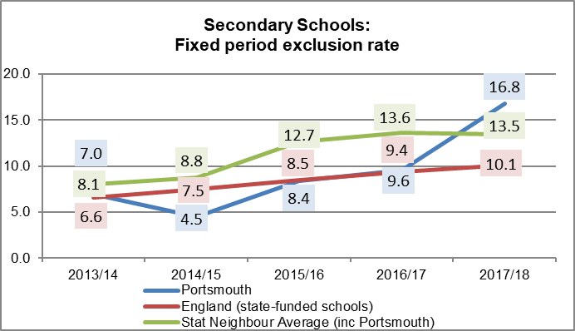
Fixed Period Exclusions - Secondary
The fixed period exclusion rate in Portsmouth secondary schools was 16.8% of pupils in 2017/18, an increase of 7.2 percentage points from the previous year
The fixed period exclusion rate in Portsmouth secondary schools is 6.7 percentage points above national and 3.3 points above the statistical neighbour average

Slide 35
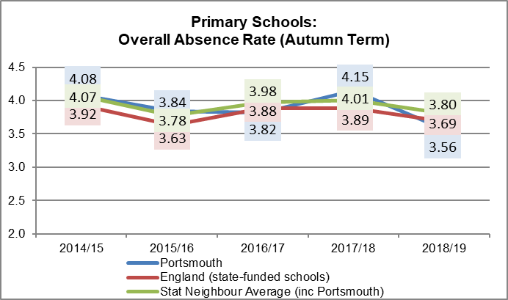
Absence - Primary Overall Absence (Autumn Term)
The overall absence rate in Portsmouth primary schools was 3.56% of sessions missed in the Autumn Term 2018/19, a decrease of 0.59 percentage points from the same term in the previous year
This absence rate was below national and the statistical neighbour average

Slide 36
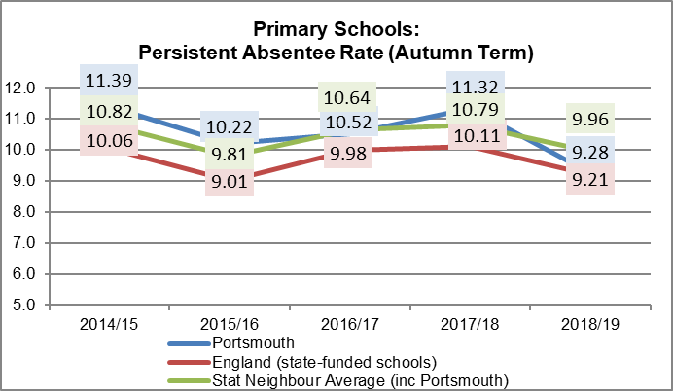
Absence - Primary Persistent Absence (Autumn Term)
The persistent absentee rate in Portsmouth primary schools was 9.28% of enrolments in the Autumn Term 2018/19, a decrease of 2.04 percentage points from the same term in the previous year
This persistent absentee rate was slightly above national and below the statistical neighbour average

Slide 37
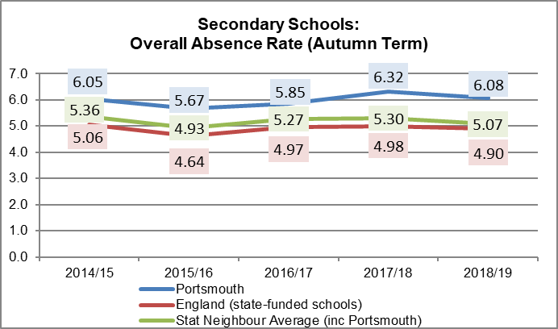
Absence - Secondary Overall Absence (Autumn Term)
The overall absence rate in Portsmouth secondary schools was 6.08% of sessions missed in the Autumn Term 2018/19, a decrease of 0.24 percentage points from the same term in the previous year
This absence rate was 1.18 percentage points above national and 1.01 points above the statistical neighbour average

Slide 38
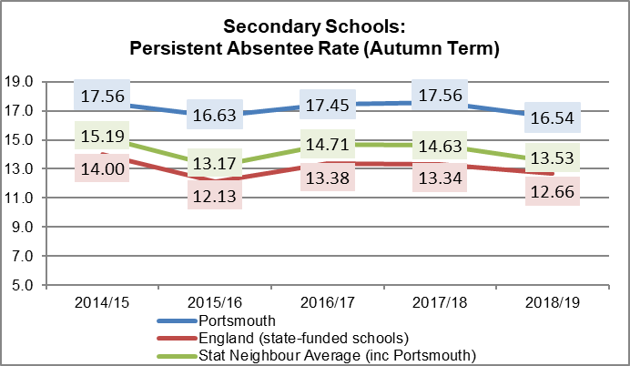
Absence - Secondary Persistent Absence (Autumn Term)
The persistent absentee rate in Portsmouth secondary schools was 16.54% of enrolments in the Autumn Term 2018/19, a decrease of 1.02 percentage points from the same term in the previous year
This persistent absentee rate was 3.88 percentage points above national and 3.01 points above the statistical neighbour average

Slide 39
School Improvement Priorities 2019-20
Improving outcomes in reading and literacy
Improving outcomes for pupils on SEN support and disadvantaged pupils
Developing the curriculum and subject knowledge

Slide 40
Inclusion and SEND updates
Inclusion and SEND updates
Julia Katherine, Head of Inclusion Sarah Christopher, PEP and School Inclusion Manager

Slide 41
SEND Local Area Inspection (1st to 5th July 2019)
SEF
Co-production
Services working together
Support for vulnerable groups
Inclusive practice
Ordinarily Available Provision
SEN Support becoming more consistent
EHCPs
‘Needs-led’ approach
School nursing
PEP
Early Help Assessments
Support for SENCos
Annual Reviews
Support in school for emotional wellbeing & SEMH

Slide 42
Areas for further development
Educational outcomes for those on SEN Support
Attendance of those on SEN support
Transition to Adult Services
Opportunities for supported employment
Support to develop independence skills (e.g. travel)

Slide 43
New Inclusion Outreach Service
Telephone helpline (3 - 5:30pm Mon to Thurs from 30th Sept)
Central training offer
Bespoke training
Support while awaiting a specialist placement
Specialist advice and support
Peer support from experienced, mainstream SENCos
Action Learning Sets
Guidance and support with the
Portsmouth Inclusive Education Quality Mark.
Notes:
To be available from October
Confirming Co-ordinator and team members now

Slide 44
SEND Information report audit
The report has been reviewed within the last 12 months?
The Ordinarily Available Provision guidance is referred to in the report

Slide 45
SEND Information report audit
There is evidence of how the report has been co-produced with parents and carers of children at the school
There is a link to the Local Offer Website

Slide 46
Portsmouth Inclusive Education Quality Mark Launch 24th January 2020
Standards
Welcoming School and Ethos (includes access & environment)
Leadership and Management
Behaviour and Safeguarding
Curriculum and Opportunities
Social & Emotional Health & Well-Being
Teaching and Learning
Monitoring Progress and Attainment
Participation of Students & Young People
Partnership with Stakeholders (Families, Governors, Community)
Transition

Slide 47
The Process
Implementation from Autumn Term 2019
Online tool shared with schools
October 19- February 20: school leadership teams self assessment against the PIE QM.
Tuesday 21st January. 10.00-11.30 Workshop for PIE QM leads
February 2020 onwards : peer moderation in triads, involvement from the Inclusion Outreach Service to ensure consistency.
Summer Term 2020 onwards: schools implementation of action plans
Notes:
Piloted during 19/19 by 9 settings:
4 primary, 4 secondary, 1 college
Different models – most successful when led by SLT, completed over a period of time with input from a number of colleagues
Self- assessment – support available from outreach service
Participating schools to be issued with a PEP Statement of Recognition to acknowledge they are committed to inclusion.
After Head’s briefing in January – PIE QM event – we would like heads to stay plus be joined by the member of you team who is leading on this. Support with process, planning next steps and triads
Self selecting triads

Slide 48
Mental Health Support Teams
Mental Health Support Teams are a new resource, funded and accountable through the NHS. They will work with, and in, schools and colleges to support them with mental health and wellbeing issues and to treat mild to moderate mental health issues.
Portsmouth will have two MHSTs (7 staff in each)
North – 15 Schools
Central / South – 17 Schools

Slide 49
MHST Project Roadmap
Milestones
Recruitment of practitioners, supervisors and team manager
Hold Link Programme Workshops for the identified 32 schools
Agree interim school placements for staff when not in training and the focus of work
Milestones
EMHP/Supervisor training begins alongside interim support for certain schools
Agree Service Model and pathways
Hold Link Programme Workshops for those schools not receiving MHST support
Milestones
Explore how the MHST model could be upscaled to all schools
Milestones
Milestones
Milestones
EMHP/Supervisor training is complete
Model to be fully implemented across all 32 schools
Qtr 3
Oct - Dec
Qtr 4
Jan - Mar
Qtr 1
Apr - Jun
Qtr 2
Jul - Sep
Qtr 3
Oct - Dec
Qtr 4
Jan - Mar
2019
2020
2021

Slide 50
The 3 Core functions of a Mental Health Support Team
Delivering evidence based interventions for mild to moderate mental health issues
Supporting the senior mental health lead in each school or college to introduce or develop their whole school or college approach
Giving timely advice to school and college staff, and liaising with external specialist services, to help children and young people to get the right support and stay in education.

Slide 51
SEMH brief updates
Survey re SEMH support to schools coming out shortly
Mental Health Awareness Training available by half-term on PLG
U Matter – talking therapies service recommissioned to cover ages 8-18

Slide 52
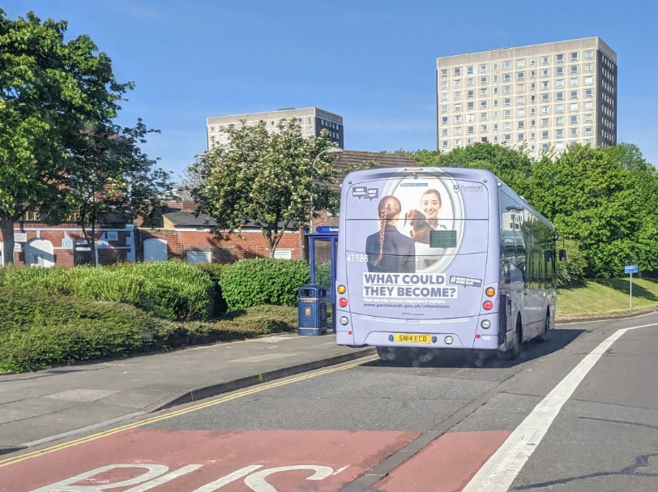
School attendance publicity campaign
Focus for Autumn term 2019: Anti-bullying

Slide 53
Feedback from focus groups
All students thought education (as a concept rather than specifically located in classroom teaching) was very important
All of the students valued education as a means to gaining a good job in the future
However,
For some students, school was seen as a source of boredom and frustration
Some students, believed they had little or no support at school
For some students school was not an enjoyable place to attend and was a site for anxiety and stress
There were lots of medical reasons for non-attendance at school

Slide 54
Traded Services Update - The Store - SLAs from 2020 onwards - School Meals
Alison Critchley Education Business and Partnerships Manager
16 September 2019

Slide 55
The “Store”
Notes:
Where we can sell “smaller” services than the annual SLAs e.g. one off events or shorter periods of support. Working with services to make sure everything they offer is available on here. Hope it will be useful to schools who want bits of service but can’t afford a whole SLA. Improvements to website also mean we’ll be able to put more complicated services on website e.g. music.

Slide 56
SLAs from 2020 onwards
Similar range of services to be offered.
Will again offer as “standard” SLA a two year agreement, with inflation added at the end of year 1, and a six month notice period.
Will also be offering for some services the option of 3 year SLAs for schools, at a confirmed price, offering a competitive price for schools able to commit for this longer period.

Slide 57
Caterlink – any early issues?
Notes:
Generally seems to have gone smoothly

Slide 58
While I’m here…..
Induction for new governors taking place now FREE. (17 Sept, 16.30 – 18.00) at the Civic Offices. Book by emailing schoolgovernor@portsmouthcc.gov.uk.
Know someone who is thinking of training to teach in September 2020? Place available on Portsmouth Teacher Experience programme – see the Teach Portsmouth website for details.
Alison.Critchley@portsmouthcc.gov.uk
023 9284 1973

