Slide 1
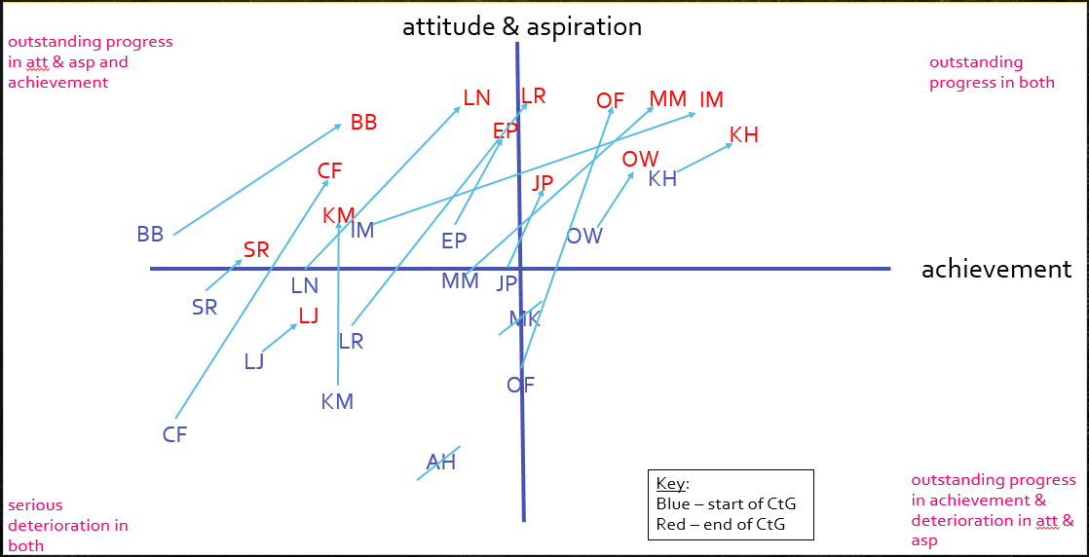
TT Rock Star Mentors
Inset School Logo
Northern Parade Junior School Kings Academy
A Year 5 programme where children are motivated to secure their rapid recall of times tables so that they can become TT Rock Star mentors for younger children. (2017-2018)
Our school
School type | Number of pupils | % Disadvantaged pupils | £ Pupil premium
Junior School | 475 | 41.68% | £184,800
Our school challenges
Data shows that our pupil premium children have not performed as well in Maths compared with non-pupil premium children and the national average.
It was identified that our Challenge the Gap cohort had poor recall of number facts. This effected their fluency of number and the underpinning knowledge required to be able to calculate and problem solve. Subsequently, this had an impact on their confidence, motivation and resilience in Maths lessons.
It was recognised that our CtG cohort had little or no parental support with practising their timetables.
How we did it
Aims:
to improve the fluency, rapid recall and general ‘number-sense’ of our pupil premium children (reduce the cognitive and working memory overload during lessons)
to develop their own confidence within Maths lessons and their independence to begin tasks with less support
to support their resilience in calculation and tackling problem solving and reasoning
to become more socially confident amongst peers
What we did:
Initially, we tried to develop a system for pre-teaching knowledge and understanding before a strand of Maths arose. However, this proved to be too demanding on time, planning and resourcing and was not proving to have a positive impact on learning or motivation (the children saw it as ‘another’ intervention).
We needed something less complicated, more motivational and manageable. We decided to use the TT Rock Star game on Ipads. It is a free resource, uses technology to engage children and is competitive.
We did not want the programme to appear as an ‘intervention’ as this can be demotivating. As an initial hook, the CtG cohort received an exclusive invitation to a ‘Rock Music’ launch party. Here, we explained that they had been specially chosen to be potential TTRock Star Mentors. The ‘carrot’ -their challenge -was to become proficient at their Times Tables so that they could graduate from the programme and become Mentors.
The CtG cohort were divided into ‘Rock Bands’ so that bands could ‘battle’ each other as well as competing to beat their own scores. Correct answers and quicker speeds lead to scoring points and winning coins to spend on designing personal avatars. This was found to be very motivational. League tables were also celebrated regarding personal progress.
Each Rock Band had 2x 30 min sessions a week to ‘play’ and practise their times tables as well as a personal log-on to use at home.
Graduating as a Mentor means that: children have shown they are proficient at times table recall, receive a prestigious ‘Mentor’ lanyard and certificate in Assembly, get an early lunch to mentor in Year 2’s TTRS club (also a focus for support for KS1 SATs) … AND develop kudos amongst their peers.
Our impact
All children have:
become more confident and fluent in their rapid recall of number facts
improved their speed and scores in TTRS and weekly times table tests
grown in mathematical confidence and attempt more maths with greater independence
Most have:
made good progress in outcomes of end of year Assessment tests
grown in confidence generally in class & across the curriculum
more able to verbalise their reasoning with greater ease
graduated as TT Rock Star mentors (10/14)
50% of CtG cohort met ARE at end of year
At the end of year, Yr 5 PP children out performed non-PP children at ARE or above by 3%
What we learnt
We believe we have gone some way to reducing a barrier to learning generally
Children have felt competitive and more intrinsically driven to improve an area of Maths (and therefore less reliant on parents for support)
Children have grown in confidence and self esteem, which has had a positive impact on them as independent learners generally across the curriculum
PP children are now generally performing in line with non PP children in Maths
The programme had wider social and well-being benefits for some children – “TT RocK Stars is fun! I like using Miss McCracken’s Ipad in the mornings – its much better than waiting for ages in the cold playground because of my early bus!” “I was rubbish at Maths and my times tables before. My score used to be 18 and now it’s 96! Look at me…I’m like an expert!”
Because of the size and structure of the school, we have decided to cascade CtG in a way that suits each year group.
We did not want to force a square peg into a round hole just because it worked in Year 5 2017-2018.
Each year leader will decide upon their own topic for their CtG project based on their own evaluation of needs and data– which they will all put in place next year.
Our CTG team from this year, will support and guide them with the structure and hopefully help them to avoid some of the pitfalls we came across.
We also aim to improve and develop how we track data and progress for our CtG cohort
Want to find out more?
Find out what else the team at xxx are doing to improve outcomes for all their pupils: contact [school contact email].
Speak to the Challenge the Gap Programme Coordinator, Roisin Killick contact roisin.killick@challengepartners.org

