Slide 1
Working with adolescent risk and resilience masterclass
Dez Holmes
Director
Research in Practice

Slide 2
Session objectives
To consider how adolescent risk can be addressed more effectively, by:
Reflecting on the evidence on attachment patterns in adolescence;
Briefly exploring evidence around adolescent development, including brain development;
Considering adolescent risk and behaviour, and challenging notions of ‘choice’;
Highlighting how services and practice can better build resilience including the role of relationship-based practice and participation;

Slide 3
Reflecting on adolescence
What one word might describe you as a teenager…?
Can you think of something risky that you did as a young person?

Slide 4
Mind the gap…
Child protection (‘rescuing babies from harm in the family’)
Making Safeguarding Personal (‘Person-led, risk-enablement, choice & control’)

Slide 5
What makes adolescents so special?
The range, nature and causes of adolescent risks are different than those faced by groups younger / older than them → a distinctive set of interconnected needs.
The impact of maltreatment often manifests differently to that of maltreatment at a younger age.
Adolescence itself provides a unique array of strengths and opportunities as a result of social and physiological development processes.
BREAKING: they don’t cope better because they’re older

Slide 6
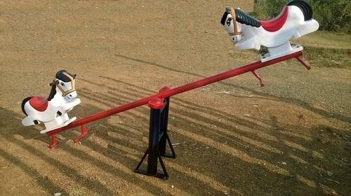
Rescue Vs Reform

Slide 7
An awkward fit
Physical abuse
Adult to YP violence
Mutual adult – YP violence
Victim of gang-related or community violence
Physical violence from partners
Sexual abuse
CSE (gangs & groups)
Sexual abuse by peers
Sexual abuse (IPR)
Exposure to CSE
Duress to engage in sexual abuse
Online sexual abuse
Intrafamilial
CSA (other adults)
Emotional abuse
Verbal abuse from family
Verbal abuse between family & YP
Bullying
Exposure to CSE, drugs, gangs etc.
Living with parental DV
Abuse from partners
Neglect
Familial neglect
Neglect in custody
Overly restrictive parenting

Slide 8
But where do these risks sit?
- eating disorders
- self-harm
- substance misuse
And some risks don’t neatly fit, e.g.
- homelessness: sometimes neglect, sometimes not
- abuse from partner can divide into 3 categories (emotional, physical and sexual abuse)
New categories / expanded definitions are unlikely to help

Slide 9
… many adolescent interventions are either downward extensions of adult programs or upward extensions of child programs …
(Thornberry et al, 2010)
… the biggest challenge is prioritising them … we can’t rush out to a sixteen year old who’s perhaps sofa-surfing and perhaps experimenting with drugs and getting into crime … we can’t prioritise that when we’re working with 0 to 5 year olds in, you know, some pretty dire situations.
(Gorin and Jobe, 2013)

Slide 10
It’s about relationships
So it is in relationships with other people that one learns to understand oneself. And by understanding one’s self, one begins to understand other people. Thus the world of relationships is both the problem to be solved and the means to its solution.
(Howe et al, 1999)
To develop normally, a child requires progressively more complex joint activity with one or more adults who have an irrational emotional relationship with the child.
Somebody’s got to be crazy about the kid.
That’s number one. First, last, and always.
(Bronfenbrenner, 1971)

Slide 11
Attachment and adolescence (Shemmings, 2011)
Secure children are not dealt a ‘good hand’ at birth - they are given those cards by their primary carers.
Doesn’t mean that insecurely attached children are destined to a life of unhappiness, addiction and stress.
Close relationships of insecurely attached people can become strained and fractured - find it difficult to trust others and other people will find them hard to understand.

Slide 12
Adolescence and disorganised attachment (Shemmings, 2011)
Children who have experienced abuse/neglect/ prolonged disorganised attachment (DA) = likely to find caring and supportive relationships frightening and perplexing – will tend to avoid them.
DA in infancy can lead to dissociative symptoms in adolescence and early adulthood, e.g.
severe panic attacks
blanking out and difficulty remembering events
an inability to keep intrusive thoughts/images out of one’s mind.
Likely to do things to make adults reject them.

Slide 13
Adolescent attachment
Research shows that attachment security in adolescence exerts precisely the same effect on development as it does in early childhood: a secure base fosters exploration and the development of cognitive, social and emotional competence.
(Moretti & Peled, 2004)

Slide 14
Reflecting on adolescent attachment
Thinking about what you know about attachment patterns, and how these can present in adolescence:
Read/reflect on Jack’s story
How has the system responded – or not – to Jack’s attachment needs?
How could a more attachment-oriented local system respond to Jack?

Slide 15
Adolescent development
The characteristics of transitions include:
An eager anticipation of the future
A sense of loss or regret for the stage that has been lost
A sense of anxiety about what is unknown
A major psychological readjustment
A degree of ambiguity of status during the transition
Key areas of development:
Physical development (puberty, brain development)
The role of the family
Identity
Peer relationships (risks and opportunities)
Health (and mental health)
(Coleman, 2014)

Slide 16
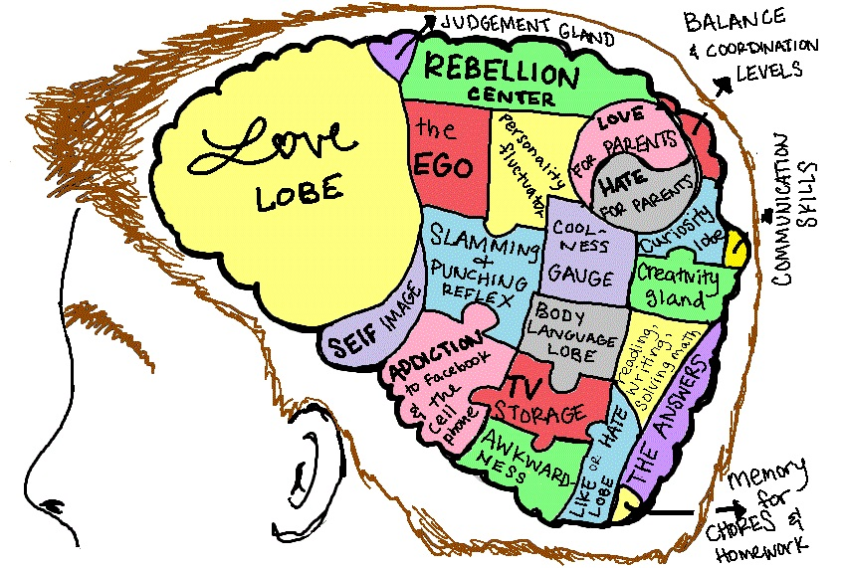
Image taken from: http://ourvoiceteen.blogspot.co.uk/2012/06/my-teenage-brain-takes-that-as-insult.html

Slide 17
Family relationships
If parents are absent/disengaged, or where there is conflict/violence – outcomes likely to be worse.
Risk factors –
harsh/erratic discipline
lack of employment (parents)
parental mental health problems
parental substance misuse (Coleman, 2014)
Authoritative parenting – warmth, structure, age-appropriate autonomy.
Behavioural vs. Psychological control (Holmes et al, 2013)

Slide 18
Peer relationships (Coleman, 2014)
YP remain hugely influenced by parents’ attitudes and behaviour.
Friends provide:
companionship
a reliable alliance (someone to be on your side)
help (in times of need)
intimacy (someone to share things with)
self-validation (to show you are accepted by others).
Open to the negative influences if have low self-esteem and low levels of support from home (Cotterell, 2007)
Influence of social media – threats and opportunities.

Slide 19
Reflecting on adolescent development
Thinking about what you know about adolescent development, consider:
How has the system responded – or not – to Jack’s developmental needs?
What support do you (and your staff / managers) need to help understand and work with adolescent development?

Slide 20
‘Risk-taking’ and adolescence
Biological, psychological and social changes - more likely to engage in risk-taking behaviours (Calkins, 2010)
Can be positive - learn about harm and safety, find out the limits of sensible behaviour (Coleman, 2014)
Ego-syntonic risks
The challenges for us:
identify most promising ways of engaging YP to divert them from risky behaviours
address the impact of risky behaviours when they’ve already taken place.

Slide 21
Risk factors for maltreatment in adolescence
Parental substance abuse
Parenting issues – lack of supervision
Reciprocal links between behaviour and parenting (Rees et al, 2010)
Family violence
Violence within intimate teenage relationships
Neglect (most common)

Slide 22
Vulnerability
Conceptions of vulnerability are central to the way risk is classified
The totality of a YP’s vulnerability may not always recognisable from apparently isolated incidents
Factors interact in complex ways, and vary over time and between individuals
Behaviour / ‘choices’ can eclipse all else
Simplistic checklists / ‘predictive’ assessment tools are problematic
So, professionals must have time to really know young people to exercise judgment

Slide 23
Adolescent choices and behaviours
Increased risk-taking, emotional highs and lows, sensitivity to peer influence - underpinned by interacting social and neurobiological changes
Adapted to harms experienced in earlier childhood
Unmet needs - seek to meet via risky routes
Adolescent choices are part of the problem and part of the solution
Misinterpreted as rational informed adult ‘lifestyle choices’ → Victims being denied appropriate support / permission to give up
Conversely, professionals can minimise adolescent choice and agency

Slide 24
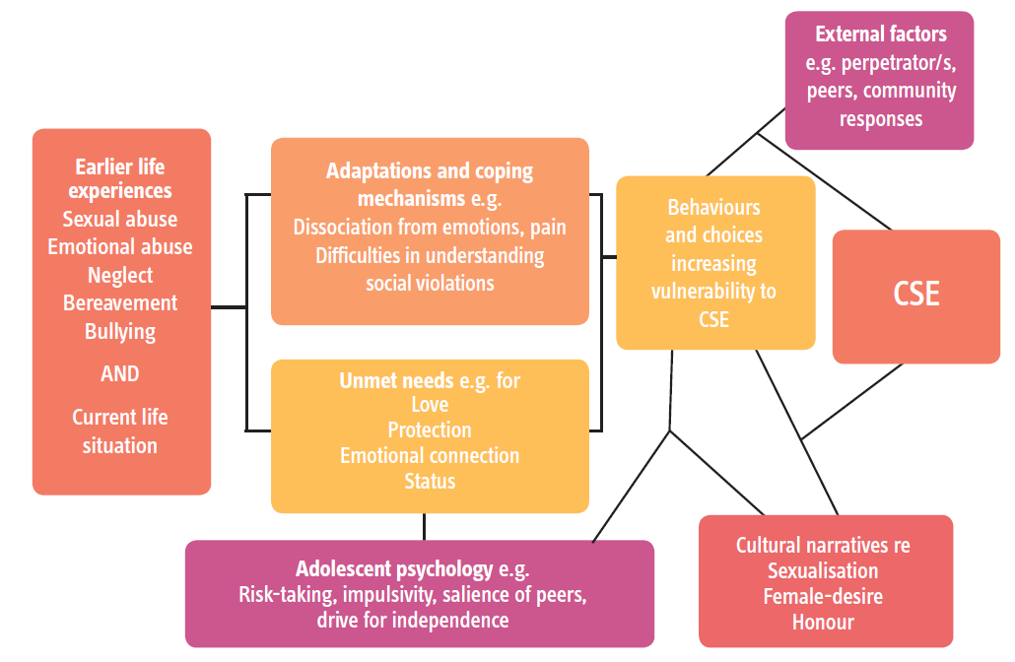
Example of sexual exploitation
e.g. Reid (2011); DePrince (2005); Kaestle (2012)

Slide 25
Young people want…
Vigilance: to have adults notice
Understanding & action: to understand what is happening; to be heard; to have that acted upon
Stability: to develop a stable relationship of trust
Respect: to be treated with the expectation of competence
Information & engagement: to be informed & involved in procedures, decisions, concerns & plans
Explanation: to be informed of the outcome
Support: to be provided with support
Advocacy: to be provided with advocacy to assist in putting forward views
(HM Government, 2015)

Slide 26
“I was throwing hints to people an’ all. I was throwing hints ‘cause I didn’t want it comin’ out of my own mouth. I wanted people to work it out … I was getting myself drunk so I could come out with it, ‘cause I couldn’t say it when I was like sober. I was like ‘I can’t say it’ ”
(young person cited in Beckett, 2011)

Slide 27
Reflecting on adolescent risk and choice
How have Jack’s ‘choices’ possibly been misinterpreted?
How are you (and your staff / managers) supported to navigate the complex nature of adolescent risk, behaviour and ‘choice’?

Slide 28
Recognising and promoting resilience

Slide 29
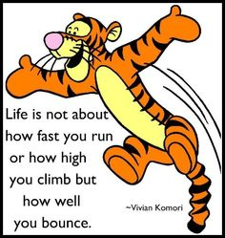
Resilience can be defined as the ability to withstand and rebound from disruptive life challenges, strengthened and more resourceful.
(Walsh, 2008)

Slide 30
Resilience in adolescence (Coleman, 2014)
Types:
Avoiding risks that adolescents are predisposed to following earlier adversity or maltreatment in childhood, e.g. avoiding sexual revictimisation.
Avoiding serious risks (e.g. substance misuse) that adolescents may be predisposed to by virtue of their developmental stage (these overlap with the category above).
Avoiding significant risks in the environment – e.g. avoiding victimisation in a violent neighbourhood.
Avoiding longer-term harm associated with any of the above sets of risks – e.g. avoiding addiction following substance misuse, or finding well-being and stability after an episode of running away.

Slide 31
Promoting resilience in CYP
Relationships are paramount (Coleman, 2014)
Self-efficacy, positive identity development, aspirations - commonly associated with resilience
‘Inoculation’
CYP as assets (Young Inspectors, Student Council)
Mentoring / Peer mentoring (DuBois et al, 2011)
Authoritative parenting to reduce harm (e.g. intensive family interventions, PACE relational safeguarding model)

Slide 32
Defining participation
Defined as children taking part in and influencing processes, decisions and activities that affect them, in order to achieve greater respect for their rights (Lansdown, 2002)
Children's rights to protection and participation are mutually dependent and indivisible
(UNCRC)

Slide 33
Participation in CSE* practice
Involves work with children individually and collectively to:
Access information, resources and support
Exercise autonomy & choice
Experience of a sense
of control
Influence & inform
change
* Or youth offending,
Mental health,
Education, etc
Communities
Services
Peers
Individual care
Research and Policy

Slide 34
Participation as protective?
(Warrington, 2016)
Consequences of CSE | Benefits of participation
YP don’t recognise exploitative situation | Critical thinking/better understanding (AYPH, 2014)
Lack of power/control | Agency and decision-making power
Isolation/sense of ‘difference’ (Reid & Jones, 2011) | Sense of belonging (Hagel, 2013)
Stigma | Approval/acknowledgement (Batsleer, 2011)
Low self worth/lack of purpose | Helping others (Batsleer, 2011, Levy, 2012, AYPH, 2014)

Slide 35
Participation as protection
Increasing self-efficacy
An important part of getting over things yourself can happen when you feel like you are helping other people; to feel like you are making something good come out of something bad (AYPH, 2014)
Reducing resistance and countering cultures of silence
Having choices makes you more likely to open up and talk to someone (AYPH, 2014)

Slide 36
When we deny victims’ self-efficacy…
“I was basically a puppet. When they [the police] wanted me, I had to do it. When they didn’t want me, I heard nothing.”
“Workers expect you to tell them everything about your lives but then they tell you nothing about theirs . ... That’s how the men work too – they find out everything about you then don’t even tell you their real name.”
(See Camille Warrington’s work)

Slide 37
and this stuff is hard and uncomfortable…
“If you are taking something away that we see and experience as positive, fun or good, you must help us find an alternative that it is also positive, good and preferably fun”
(Young person cited in Purple Monsters, 2014)
“A lot of people have pushed us into things, have forced us to do things and made a lot of decisions for us and we don’t need the people who are there to help us, to do it as well”
(Young person cited in Jago et al 2011)

Slide 38
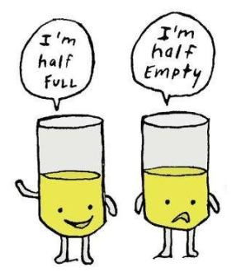
7 learnable skills of resilience
Emotional awareness or regulation
Impulse control
Optimism
Causal analysis
Empathy
Self-efficacy
Reaching out (taking appropriate risk)
(Reivich, 2005)

Slide 39
The role of Relationship-Based Practice (RBP)

Slide 40
Modelling RBP
Recognises the complexity of human behaviour and relationships: people are not rational beings.
Understands anxiety as a natural response to distress and uncertainty.
Acknowledges social welfare practice as complex, unpredictable, and full of uncertainty.
Recognises that establishing meaningful professional relationships is the key to engagement.
(Ruch, 2005; Ruch et al, 2010; Munro, 2011)

Slide 41
Key features of RBP in action
Communicating respectfully: trust, honesty and feeling safe.
Sharing goals: being clear about concerns and taking YP/family with you.
Practical assistance and understanding family’s needs, while ensuring YP remains central focus.
Being reliable, available and building services around YP’s/family’s needs.
(Mason, 2012)

Slide 42
Panning for gold…
Read Michelle’s history and chronology.
Listen to Michelle’s story.
Think about Michelle’s story and consider:
Are there resilience factors that you (or your staff) could build upon?
(Case study taken from DfE, 2012)

Slide 43
A different approach
A distinctive adolescent-centered approach is required.
Adolescents are not simply young adults or old children. Risks, pathways to and impact of, are different from those of other age groups.
This developmental stage holds distinctive strengths and opportunities.
All this has implications for policy and practice.

Slide 44
Seven principles to improve responses to adolescent risk
Work with adolescent perception, agency, aspiration, skill and development
Work with young people as assets and resources
Promote supportive relationships between YP and their family and peers (where possible)
Prioritise supportive relationships between YP and key practitioner/s
Holisticism
Accessible and advertised services
Equip and support the workforce

Slide 45
Recognising vulnerability
Adolescent-centered | Process-driven
Recognises effects of abuse on development | Assumption of resilience
Recognises effects of past trauma on behaviour | Focus on current abuse and risk
Recognises different sources of harm: self, family, community | Confusion re source of harm
Recognises normal vs harmful risk-taking | Underplays and overstates risk and harm
Recognises root causes of surface problems | Identification and referral for symptoms not causes

Slide 46
Disclosure
Adolescent-centered | Process-driven
Help to see their experiences as abuse/ neglect | Expectation that: - They will ask for help if they need it - Actions are a result of rational choices
Sustained trusted relationship with key professionals | Stop-start support and fragmented relationships
Recognises barriers to disclosure | Single visit to ascertain views, wishes and feelings
Assurance that disclosure will lead to action – and control | Repeat referrals , YP agency is underplayed / overplayed

Slide 47
Support
Adolescent-centered | Process-driven
Proactive casework and timely decision-making | Reactive casework and delayed decision-making (Brown and Ward, 2012)
Support to manage risks from a range of sources | Challenge to ‘improve’ parenting & change behaviours
Focus on self-esteem and sense of agency | Passive recipients of crisis support
Persistence and tenacity | Short-term interventions
Engaging and enticing programmes of support | Routine visits and case review
Explicit responsibility for harm = perpetrators | Mixed messages

Slide 48
Care
Adolescent-centered | Process-driven
Respite to avoid family breakdown | Binary approach to care (emergency admissions)
Stable placements | Multiple changes in placement
Connections to family and social networks | Out of area placements
Supported reunifications | Unplanned and unsupported returns to family home
Support into adulthood | Patchy / cliff-edge support for care leavers

Slide 49
Workforce
Adolescent-centered | Process-driven
The right person, with the right skills – well held | Hierarchical case allocation
Valued practitioners and managers | Pilloried scapegoats
High quality L&D and supervision | Patchy L&D & supervision
Skills & expertise ‘drawn down’ | Cases passed ‘up’
Judged on doing the right thing | Judged on doing things right

Slide 50
Concluding thoughts
Being more adolescent-centred in our approach to risk, need and resilience will likely be both effective and cost-effective in the longer term
Requires risk-taking, innovation and courageous leadership
Requires a more fundamental shift across the whole of society in how we view young people
- appreciating their agency
- acknowledging them as citizens and assets
- tackling societal contexts that ensnare and discriminate
If not now, then when…?

Slide 51
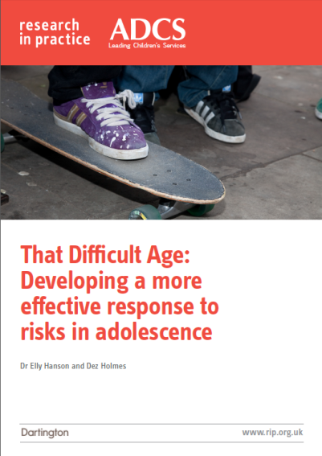
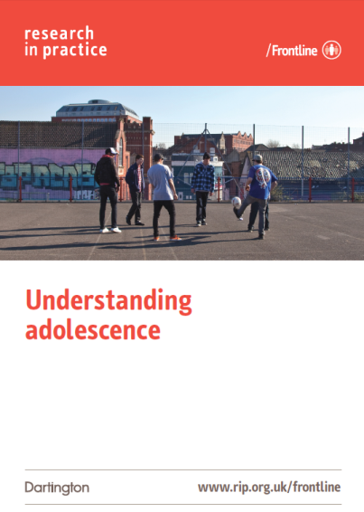
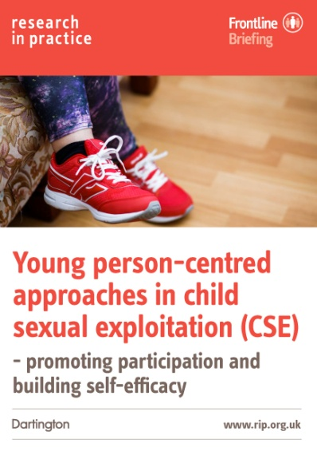
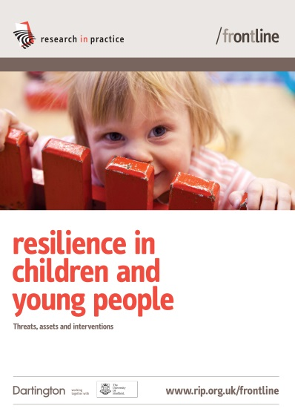
Thank you

