Slide 1
Primary
Warning!
This week we are discussing some really sad events that have been in the news. If you feel at all upset, worried or nervous about anything, let your teacher know.

Slide 2
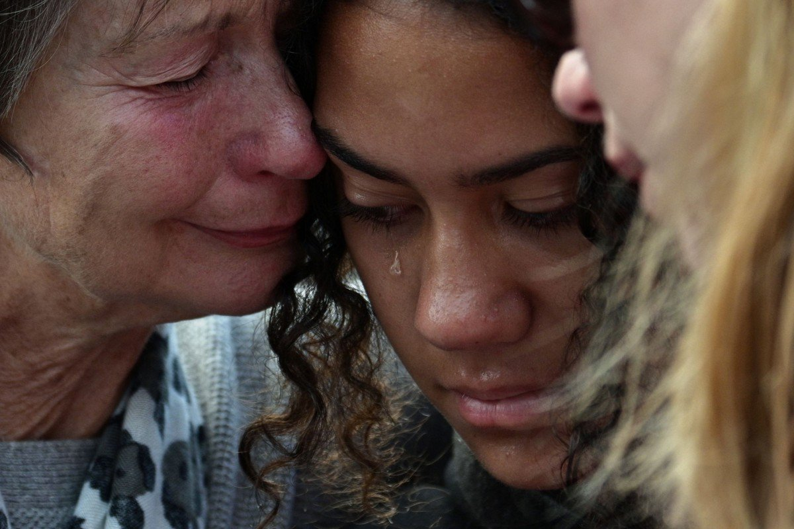
Starter thoughts (2-4 mins)
How does this photo make you feel? Have you ever felt like this?
©VotesForSchools2019
Notes:
Images:
1- https://www.scmp.com/news/asia/australasia/article/3002022/new-zealand-police-say-death-toll-mosque-terror-attack-has

Slide 3
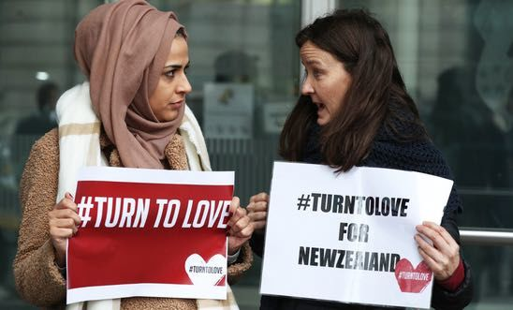
Does tragedy bring people together?
‘Tragedy’ means an event that is very sad. It is when something happens that makes you really upset.
©VotesForSchools2019
©VotesForSchools2019
Notes:
Images:
1- https://www.amnesty.org.uk/press-releases/new-zealand-world-leaders-must-stand-against-hate-filled-ideology-following-horrific

Slide 4
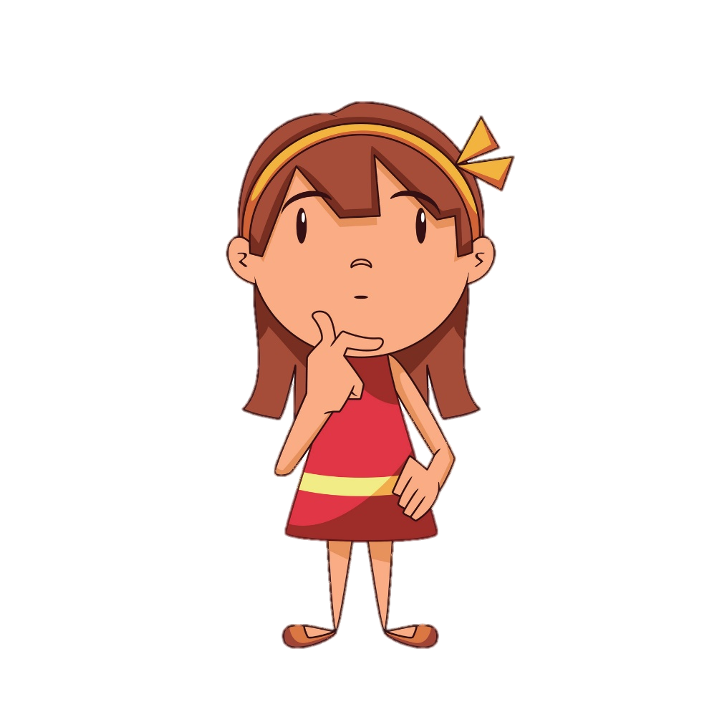
What happened last week?
Pair question (2-4 mins)
Why do you think we are talking about upsetting events today?
Can anyone think about what has happened in the news recently?
©VotesForSchools2019
©VotesForSchools2019
Notes:
Image Source:
1-
References:
1-

Slide 5
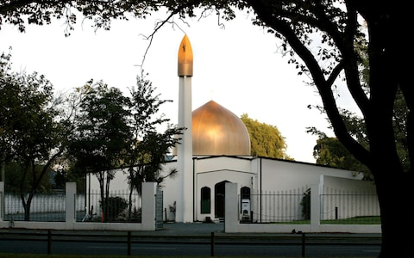
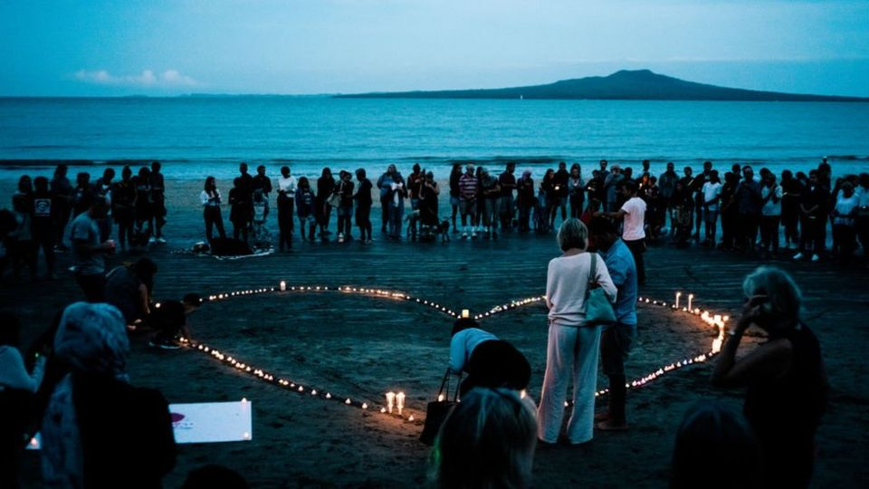
What happened last week?
Last week, something very upsetting happened on the other side of the world, in New Zealand. In Christchurch, there were terrible attacks at two mosques which shocked the whole country.
The tragic events have made people very upset. But millions have responded to what has happened with messages of kindness, love, hope and support.
©VotesForSchools2019
©VotesForSchools2019
Notes:
Image Source:
1-
References:
1-

Slide 6
Our learning journey for today
What happened last week?
The world’s reaction: what was it like?
What happens when we get upset?
Can sad events push us away from each other?
What can we do to help others?
©VotesForSchools2016
Notes:
Image Source:
1- iStock images
2-http://static6.uk.businessinsider.com/image/5924bf345823511d008b48db/13-powerful-images-from-last-nights-vigil-remembering-the-manchester-attack-victims.jpg
3- http://www.deepsouthmedia.co.uk/7967-2/
References:
1-

Slide 7
The world’s reaction: what was it like?
Pair talk (3-5 mins)
On the next six slides are examples of how people around the world responded to the news of this attack.
Discuss: Is there anything similar about these reactions?
©VotesForSchools2019
©VotesForSchools2019
Notes:
Image Source:
1-
References:
1-

Slide 8
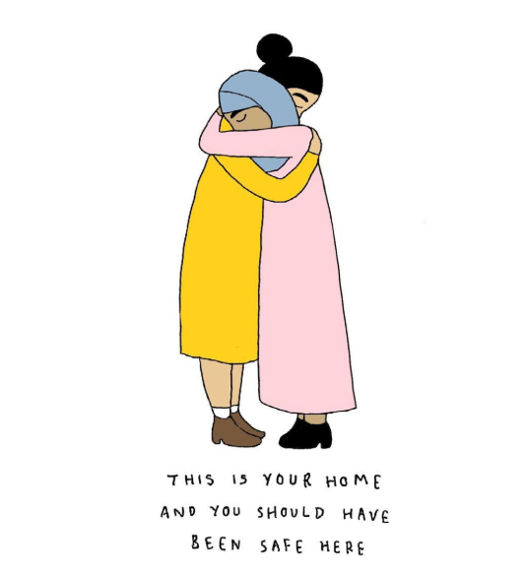
The world’s reaction: what was it like?
People took to social media and posted drawings expressing their feelings.
©VotesForSchools2019
©VotesForSchools2019
Notes:
Image Source:
1-https://eu.tennessean.com/story/opinion/2019/03/15/new-zealand-shooting-we-must-stand-up-hatred-leads-tragedy/3179159002/
References:
1-

Slide 9
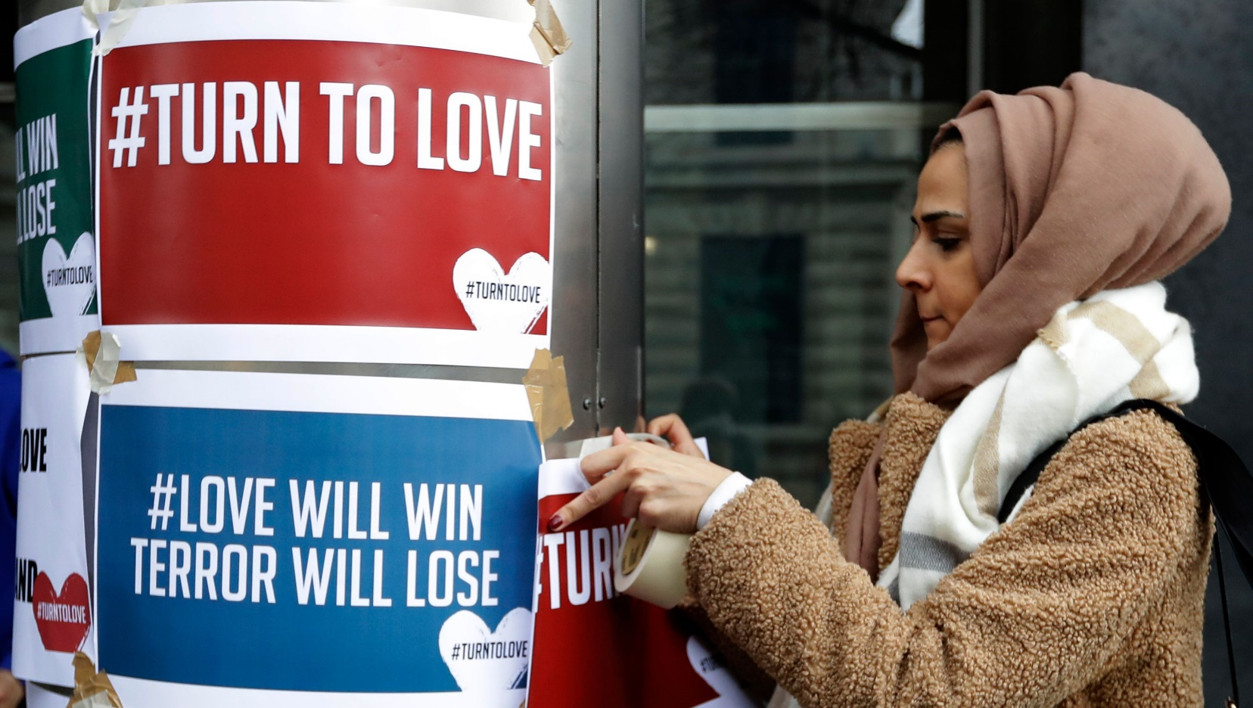
The world’s reaction: what was it like?
People took to the streets to express their views on these events.
©VotesForSchools2019
©VotesForSchools2019
Notes:
Image Source:
1-https://eu.tennessean.com/story/opinion/2019/03/15/new-zealand-shooting-we-must-stand-up-hatred-leads-tragedy/3179159002/
References:
1-

Slide 10
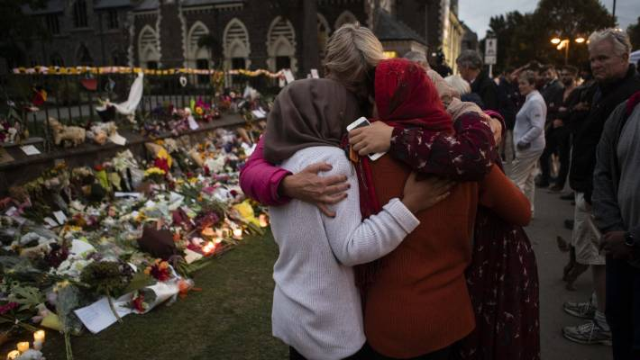
The world’s reaction: what was it like?
People comforted each other in Christchurch, New Zealand.
©VotesForSchools2019
©VotesForSchools2019
Notes:
Image Source:
1-https://www.stuff.co.nz/national/111354045/christchurch-comes-together-at-impromptu-vigil-for-terror-attack-victims
References:
1-

Slide 11
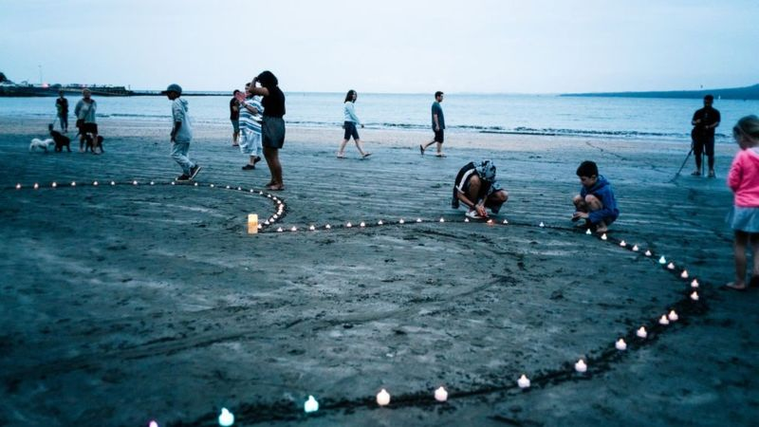
The world’s reaction: what was it like?
Children created a candlelit heart on a beach in New Zealand.
©VotesForSchools2019
©VotesForSchools2019
Notes:
Image Source:
1-
References:
1-

Slide 12
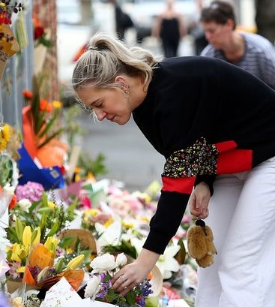
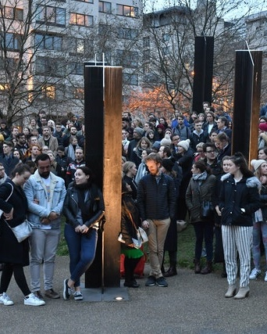
The world’s reaction: what was it like?
Flowers were laid and candles were lit in cities across the UK.
©VotesForSchools2019
©VotesForSchools2019
Notes:
Image Source:
1-
References:
1-

Slide 13
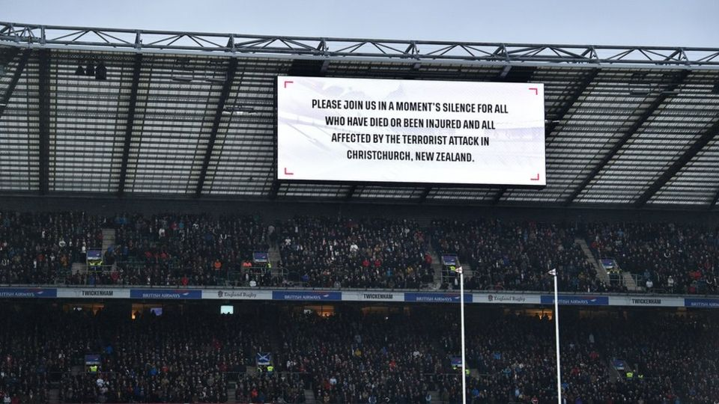
The world’s reaction: what was it like?
Players and fans at the Six Nations rugby observed a moment of silence.
©VotesForSchools2019
©VotesForSchools2019
Notes:
Image Source:
1-
References:
1-

Slide 14
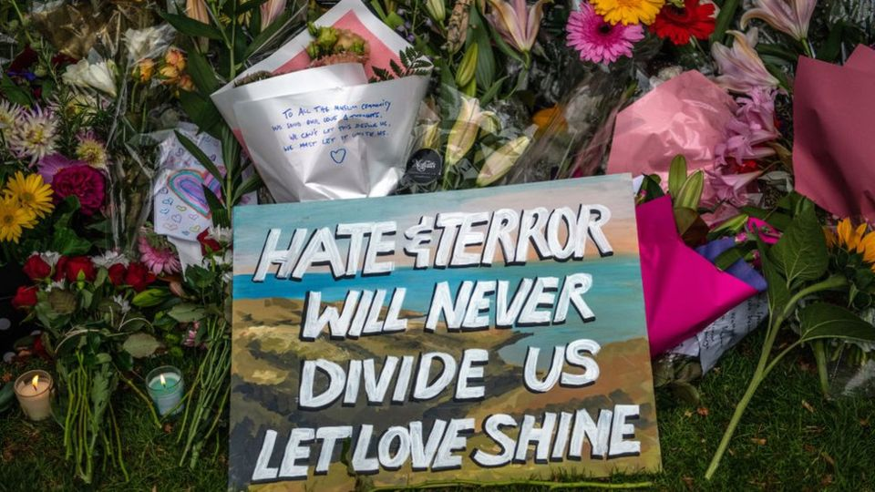
The world’s reaction: what was it like?
Homemade signs like this were found at vigils all over the world.
Vigil:
The act of staying awake, especially at night, to make a protest, or to pray.
©VotesForSchools2019
©VotesForSchools2019
Notes:
Image Source:
1-
References:
1-

Slide 15
Our learning journey for today
What happened last week?
The world’s reaction: what was it like?
What happens when we get upset?
Can sad events push us away from each other?
What can we do to help others?
©VotesForSchools2016
Notes:
Image Source:
1- iStock images
2-http://static6.uk.businessinsider.com/image/5924bf345823511d008b48db/13-powerful-images-from-last-nights-vigil-remembering-the-manchester-attack-victims.jpg
3- http://www.deepsouthmedia.co.uk/7967-2/
References:
1-

Slide 16
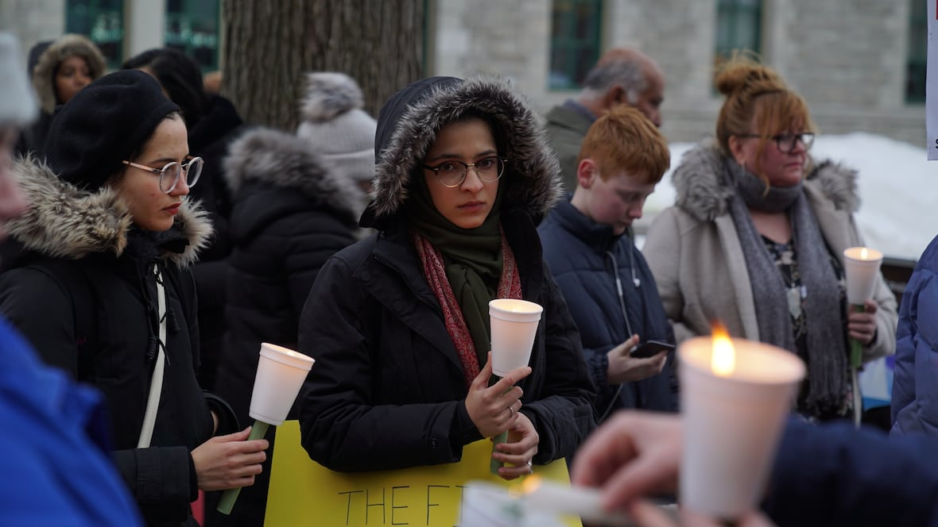
What happens when we get upset?
On your own, have a think about these questions:
Have you ever felt really sad or upset?
Did your family and friends help you when you were upset?
©VotesForSchools2019
©VotesForSchools2019
Notes:
Image Source:
1- iStock Images
2-
References:
1- https://en.oxforddictionaries.com/definition/environment

Slide 17
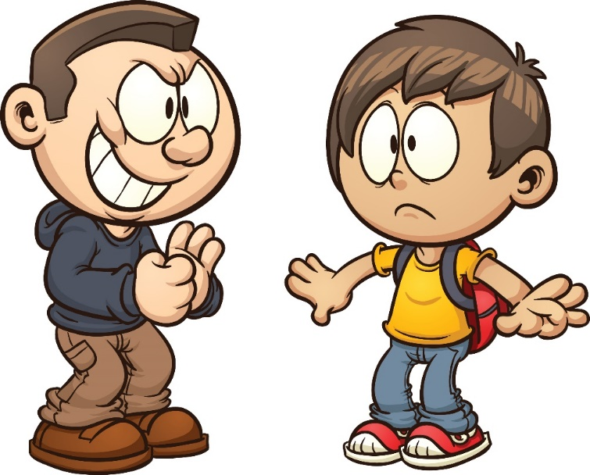
What happens when we get upset?
Imagine a bully calls you names during playtime. They say nasty things about you and try to scare you.
Pair talk (3-4)
In pairs, discuss:
1) How would you feel about the bully?
2) Could anyone help you? How?
3) How would you feel about the people who help you deal with this?
Sad events can be really hard to get through. We need people to help us. When family, friends, and those around us help, it can bring us closer together. But we still might be angry or worried by the bully. In a much more serious way, this is what can happen after events like those in Christchurch, New Zealand.
©VotesForSchools2019
©VotesForSchools2019
Notes:
Image Source:
1-
References:
1-

Slide 18
Our learning journey for today
What happened last week?
The world’s reaction: what was it like?
What happens when we get upset?
Can sad events push us away from each other?
What can we do to help others?
©VotesForSchools2016
Notes:
Image Source:
1- iStock images
2-http://static6.uk.businessinsider.com/image/5924bf345823511d008b48db/13-powerful-images-from-last-nights-vigil-remembering-the-manchester-attack-victims.jpg
3- http://www.deepsouthmedia.co.uk/7967-2/
References:
1-

Slide 19
Can sad events push us away from each other?
Pair talk
(3-5 mins)
Have a look at these two paths. As a pair decide:
Which path do you think will make people happier?
Which path would you choose? When something bad happens to you, do you blame people or try to help them?
Do you think there are any other paths?
We can look for someone or a group to blame for the tragedy.
We can separate ourselves from that person/group and point out how they are different.
We can then try and solve the problem by pushing that person/group away.
Path 1
Tragic event
(e.g. the attack in New Zealand)
We can focus on helping those who are the most hurt or upset.
We can come together and get to know each other and our community better.
We can look at how the whole community can make the area more safe.
Path 2
©VotesForSchools2019
©VotesForSchools2019
Notes:
Image Source:
1-
References:
1-

Slide 20
Our learning journey for today
What happened last week?
The world’s reaction: what was it like?
What happens when we get upset?
Can sad events push us away from each other?
What can we do to help others?
©VotesForSchools2016
Notes:
Image Source:
1- iStock images
2-http://static6.uk.businessinsider.com/image/5924bf345823511d008b48db/13-powerful-images-from-last-nights-vigil-remembering-the-manchester-attack-victims.jpg
3- http://www.deepsouthmedia.co.uk/7967-2/
References:
1-

Slide 21
What can we do to help others?
Now we have learned a bit more about sad events, there is a chance to help people if they ever go through difficult times. We are going to put together everything we can think of to try and help people in the future.
Our ideas on how to deal with a sad event:
…
Pair activity (5-10 mins)
Make a list of ideas/bullet points about how to deal with a sad event. Aim for around 4-5 ideas.
Once everyone has finished, bring your ideas together to make a class list to go up in the classroom.
©VotesForSchools2019
©VotesForSchools2019
Notes:
Image Source:
1-
References:
1-

Slide 22
Does tragedy bring people together? No
No
I think sad events like the attacks in New Zealand can actually make people angry with each other.
When I’m sad, I can also feel angry - sometimes I want to be away from people. So I don’t think it helps me be closer to people.
These attacks make me worried and nervous about the future.
©VotesForSchools2019
Notes:
Image Source
1-
Reference
1-

Slide 23
Does tragedy bring people together? Yes
Yes
I think the attack shows people look after each other at difficult times.
When I am ever sad about something, my friends and family look after me. I think it is the same for everyone.
I think sadness and upsetting events bring out the good in people. It makes people think about those around them who are in need.
©VotesForSchools2019
Notes:
Image Source
1-
Reference
1-

Slide 24
Vote Now on… www.votesforschools.com
©VotesForSchools2019
Notes:
Image Source
1-
Reference
1-

